Slide 1

State Allocated Private Activity Bonding in Texas
(Senate Committee on Intergovernmental Relations)
TEXAS BOND REVIEW BOARD
Governor Greg Abbott, Chairman
Lieutenant Governor Dan Patrick
Speaker Dennis Bonnen
Comptroller Glenn Hegar
Rob Latsha Executive Director

Slide 2
What is a PAB?
Title 26 Internal Revenue Code, TGC Ch. 1372
A private activity bond is a bond issued by or on behalf of local or state government for the purpose of financing the project of a private user.
Private Debt sold like a public security (tax-exempt)

Slide 3
Benefits of PABs
A lower interest rate paid on borrowed money, providing cost savings for project expenditures.
Reduced project risk. The risk is shifted to the private sector.
The opportunity to complete projects with a positive benefit for the community.
Secure tax-exempt financing to fund capital expenditures.

Slide 4
Public Benefit
Private investments in infrastructure is incentivized.
Reduced need for new taxes or borrowing. When private activate bonds make it possible for investors to finance projects that develop infrastructure, local and state governments do not need to increase taxes to provide the services.

Slide 5
Evident effects of SB 1474
Section 4 reallocated the authority among issuers/sub-ceilings
Section 13 raised and indexed the project limits
Section 14 extended the time to close

Slide 6
Program Status as of 1/27/2020
Current year started with $3.04 billion in new authority.
  $1.83 billion is currently available
2020 Volume Cap applicants
  41 Multifamily applicants have participated, 28 have received a reservation and remain active, 1 has withdrawn, and 15 are in-line.
  2 Single-Family applicants received reservations and remain active.
  1 State-Voted Issue applicant has received a reservation and remains active
  9 applicants from the “All Other Issuers” have participated, 7 have received a reservation and remain active, 2 are in line.

Slide 7
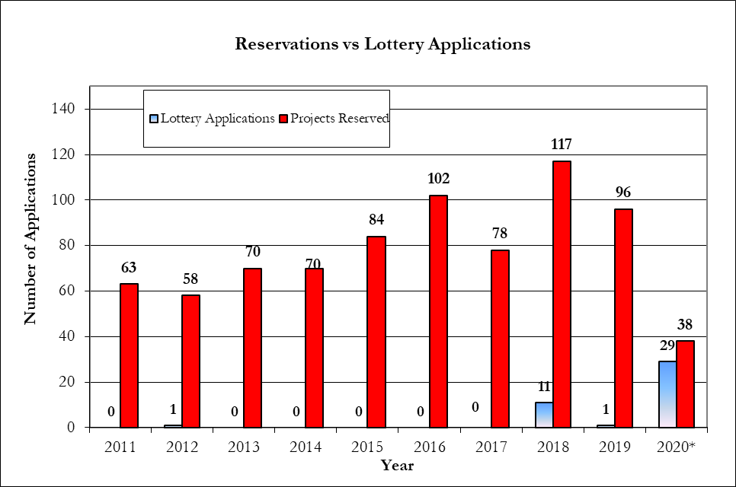
Increase in Applications, Increase in Number of Reservations

Slide 8
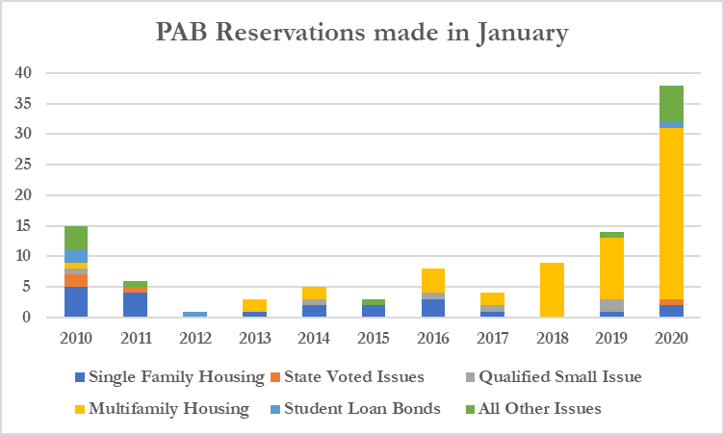
PAB January Reservations

