Slide 1
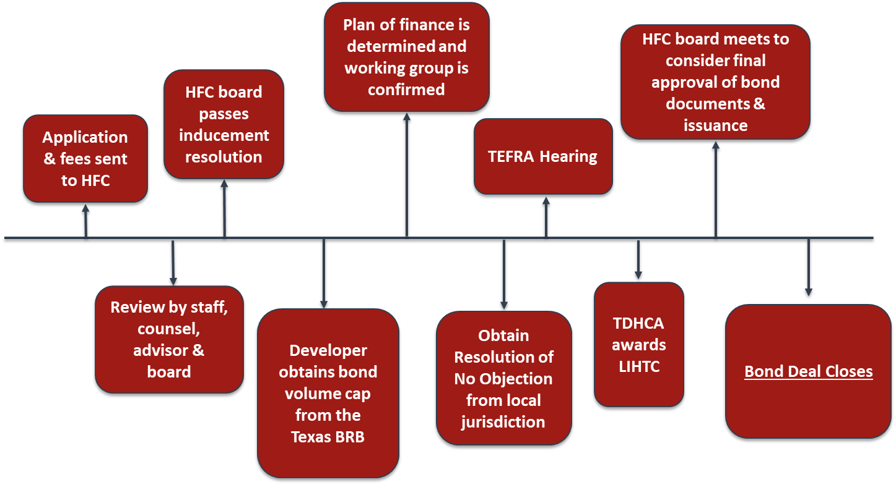
Multifamily Bond Transaction Timeline

Slide 2
Disclaimer
This communication is intended for issuers for educational and informational purposes only and does not constitute legal or investment advice, nor is it an offer or a solicitation of an offer to buy or sell any investment or other specific product or service. Financial transactions may be dependent upon many factors such as, but not limited to, interest rate trends, tax rates, supply, change in laws, rules and regulations, as well as changes in credit quality and rating agency considerations. The effect of such changes in such assumptions may be material and could affect the projected results. Any outcome or result HilltopSecurities, or any of its employees, may have achieved on behalf of our clients in previous matters does not necessarily indicate similar results can be obtained in the future for current or potential clients. HilltopSecurities makes no claim the use of this communication will assure a successful outcome. This communication is intended for institutional use only. For additional information, comments or questions, please contact Hilltop Securities Inc.

