Slide 1


Anatomy of a Bond Deal
October 19, 2023
Lauren Marcus, Esq.
Tiber Hudson
Direct: (202) 973-0122
lauren@tiberhudson.com
John Sabatier
Stifel, Nicolaus & Co.
Direct: (504) 210-3110
sabatierj@stifel.com
Notes:
1

Slide 2
Example 4% Deal Timeline (Publicly Offered)
Initial Drafts of Disclosure Docs
TEFRA Hearing & Bond Resolution
Lender Commitment & Rate Lock
Rating Received
Kick-Off Call
Price Bonds
0
120
30
60
90
Inducement
Resolution
Initial Drafts of Bond Docs
Rating Agency Submission
Issuer Board Meeting
Submit Mortgage Loan Closing Package
Post POS
Closing
Copyright © 2023 Tiber Hudson LLC

Slide 3
Working Group and Key Documents

Slide 4
The Working Group – Key Players
Borrower
Issuer and Counsel
Bond Counsel
Credit Enhancement and Counsel
Lender and Counsel
Tax Credit Equity and Counsel
Financial Advisor
Trustee and Counsel
Rating Agency
Underwriter and Counsel
Copyright © 2023 Tiber Hudson LLC

Slide 5
Key Players – Bond Counsel
RESPONSIBILITIES Hired by the Issuer to ensure the proper legal and tax issues of the financing are maintained Primary responsibility is preparation of legal documents – Indenture, Loan Agreement, Resolutions, TEFRA notice, and Arbitrage Certificate Renders opinion concerning the validity of the bond issue with respect to statutory authority, constitutionality and exemption of interest from Federal income tax Coordinates the closing and prepares final bond transcript | DOCUMENTATION Inducement Resolution Allows Borrower to use bonds to reimburse itself for expenditures made prior to issuance of the Bonds 60 day “look back” for expenses incurred prior to resolution TEFRA Notice Bonds must be approved by jurisdiction over the area where the project is to be located Requires public notice and public hearing Authorizing Resolution Issuer adopts final bond resolution; “substantially final documents” Land Use Restriction Agreement (LURA)/Regulatory Agreement Restrictions include low-income set-asides and compliance monitoring requirements Recorded and runs with the land for the Qualified Project Period Tax Certificate/Non-Arbitrage Certificate Establishes that the Bonds will not be used in a way that would make them “arbitrage bonds” Bond Counsel Opinion Opinion as to the federal (and sometimes state) tax exemption of the Bonds Trust Indenture Establishes the terms, funds and accounts to be created with respect to the Bonds Loan Agreement Establishes the terms by which the Issuer will lend the bond proceeds to the Borrower Sets forth the Borrower’s obligation to repay the loan and fulfill the Issuer’s obligation to Bondholders

Slide 6
Key Players – Underwriter and Counsel
RESPONSIBILITIES Underwriter: Analyzes financing alternatives for the Borrower Develops a plan of finance Manages the credit rating process Markets and prices the bonds Provides final cash flow analysis and arbitrage analysis Facilitates the closing of the bonds with DTC Underwriter’s Counsel: Represents the Underwriter Drafts underwriting documents – Preliminary Official Statement, final Official Statement, Bond Purchase Agreement and Continuing Disclosure Agreement | DOCUMENTATION Bond Purchase Agreement Establishes the closing date and other specific terms of the bond sale Preliminary Official Statement/Official Statement If Bonds are being publicly sold the Underwriter will use “POS” to market This is not a contract but an offering document; certain regulatory and disclosure rules apply Certifies that the Bonds will not be used in a way that would make them “arbitrage bonds” Continuing Disclosure Agreement Sets forth the obligation of the Borrower and Dissemination Agent to provide certain ongoing information to bondholders as required under Rule 15c2-12

Slide 7
Key Players – Borrower and Counsel
RESPONSIBILITIES Borrower: Develops and owns the Project Almost always a single-purpose, single-asset entity Borrowers may be: For-profit corporations Limited Partnerships 501(c)(3) corporations Governmental entities Borrower’s Counsel: Reviews all legal/bond documents on behalf of Borrower Should be experienced in real estate matters and in bond financings | DOCUMENTATION Purchase and Sale Agreement Ground Lease/Deed Real Estate Closing Statement Title Company Survey, Commitments, Affidavits and Policies Authorization Documents Seller (if an entity and not an individual) – Incumbency Certificate and Resolutions Buyer/Borrower – Incumbency Certificate and Resolutions If an Acquisition/Rehab: Bill of Sale General Assignment and Assumption Assignment and Assumption of Leases and Security Deposits Tenant Notification

Slide 8
Key Players – Credit Enhancement Provider and Counsel
Credit Enhancement Providers: Fannie Mae Federal Housing Administration (FHA) Ginnie Mae (usually “wraps” FHA-insured mortgages) USDA | Credit Enhancement Counsel: Reviews all legal/bond documents on behalf of Lender/Credit Enhancement provider Prepares most of the real estate documents securing the Lender’s interest in the property

Slide 9
Key Players – Issuer and Counsel
RESPONSIBILITIES Issuer: Issues bonds on behalf of the Borrower Typically serve as “conduits” – neither the faith or credit of the Issuer is pledged towards debt service Options vary by jurisdiction Issuer’s Counsel: Reviews all legal documents on behalf of the Issuer Helps coordinate Issuer meetings Not involved in all transactions

Slide 10
Key Players – Tax Credit Equity Investor and Counsel
RESPONSIBILITIES Tax Credit Equity Investor: Purchase tax credits from the Borrower in exchange for an equity stake in the property ownership Two types of tax credits: 9% and 4% Bridge Lender of Tax Credit Equity often used Tax Credit Equity Counsel: Reviews all legal/bond documents on behalf of Tax Credit Equity Provider Drafts partnership agreement | Documentation Partnership Agreement Bridge Loan Agreement (if applicable)

Slide 11
Key Players – Trustee/Fiscal Agent and Counsel
RESPONSIBILITIES Trustee/Fiscal Agent: Represents Bondholders’ interests Manages Trustee-held bond funds, reserves and construction funds Trustee/Fiscal Agent Counsel: Represents interests of Trustee

Slide 12
Key Players – Not Involved in All Deals
Construction Lender
Typically local or national banks May also be related to Equity Investor or Permanent Lender
Rating Agency
Standard & Poor’s, Moody’s and Fitch Ratings Rating is usually based on the rating of the credit enhancement provider Ratings have direct impact on cost of borrowing Higher the credit rating, the lower the interest cost
Construction Lender’s Counsel
Reviews all legal/bond documents on behalf of Construction Lender Prepares most of the real estate documents securing the Construction Lender’s interest in the property
Financial Advisor
Retained by the Issuer and reviews bond structure and offering documents

Slide 13

Various Types of Lenders
There are many different kinds of Lenders:
  Construction Lenders
  Permanent Lenders
  Subordinate Lenders
  Bridge Lenders
  Seller Take-back Lenders
  Developer/Sponsor
Key documents will vary based on the role.

Slide 14
Taxable Debt Executions with Short-Term Cash-Backed Bonds

Slide 15
Short Term Cash-Backed Bonds with Taxable Perm Loan
Taxable construction and/or perm loans still available in the current market at competitive rates including:
  FHA/GNMA (221(d)(4) / 223(f))
  Rural Development (538 / 515)
  Fannie loans (mod/light in-place rehab)
  Other (taxable) State and/or Local loan programs
  Soft funds (including CDBG, FEMA, etc.)
Copyright © 2023 Tiber Hudson LLC
15

Slide 16




Short Term Cash-Backed Bonds
Borrower
Bond proceeds
LP Investor
Debt service
payments
Trustee
Bond
proceeds
Cash
collateral
Lender
funds
Bond Holders
Perm
Lender
Copyright © 2023 Tiber Hudson LLC

Slide 17
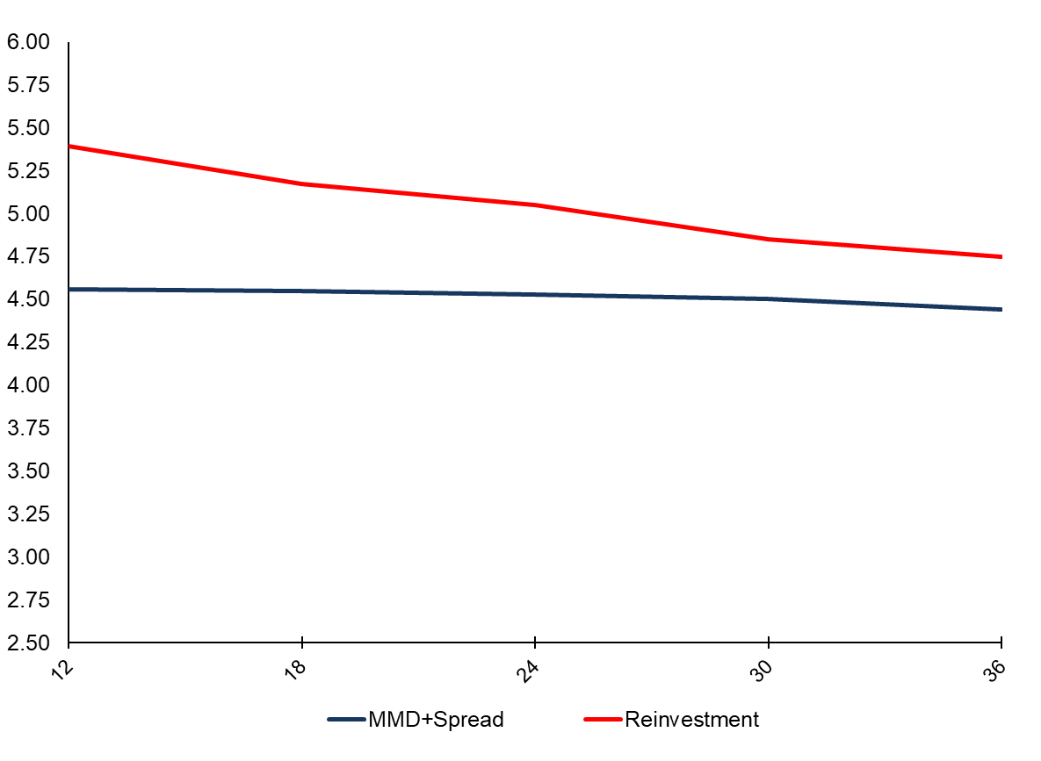
Short-Term Rates vs. Reinvestment Rates – 12 to 36 Months
POSITIVE ARBITRAGE
Source: Bloomberg. Thomson Reuters
Reflects market conditions as of October 13, 2023
Thomson Reuters Municipal Market Data (MMD) AAA curve is a proprietary yield curve that provides the offer-side of AAA rated state general obligation bonds
17

Slide 18
Long Term Bonds

Slide 19
Long Term Bonds
On the closing date, the bond purchaser or underwriter will fund the initial (or full) draw of tax-exempt debt to the trustee for the benefit of the bond issuer.
The issuer will use the proceeds of the bonds to make a loan to the borrower, which the trustee will advance in installments to the borrower during the construction period to be used on project costs.
  During the construction period, the borrower will make interest-only payments on the bonds, which will bear interest at either a fixed variable rate.
When all conditions to conversion have been satisfied, tax credit equity will be used to redeem a portion of the bonds such that the outstanding principal amount is equal to the permanent loan amount underwritten by the bond purchaser or underwriter.
  Following conversion, the borrower will make principal and interest payments on the bonds, which will bear interest at a fixed rate.

Slide 20




Long Term Bonds
At Closing
Following Conversion
Borrower
Bond
Proceeds
MBS Pass Through Payment
Trustee
Mortgage
Payments
Bond Payments
Bond Proceeds
Tax-Exempt Bonds
Bondholders

Slide 21
What are Low Income Housing Tax Credits (LIHTCs)?
21

Slide 22
4% vs 9% Deals Comparison
9% Deals
4% Deals
5%: Soft Funds/DDF
5%: Soft Funds/DDF
30%: Debt
9% LIHTC Deals:
Competitive
Tax-Exempt Bonds are not permitted
60%: Debt
4% LIHTC Deals:
Noncompetitive
Tax-Exempt Bonds are required
65%: Tax Credit Equity
35%: Tax Credit Equity
Copyright © 2023 Tiber Hudson LLC

Slide 23
50% Test
To qualify for 4% Tax Credits, the Project must utilize
Private Activity Bonds greater than 50% of Aggregate Basis
(which equals Eligible Basis plus Land)
Land
Sitework
Aggregate Basis
Financing
3rd Party Reports
COI
=
Eligible Basis
Tax-Exempt Municipal Bonds
(>50%)
Construction Contract
Ex: If a Project has $20mm in Aggregate Basis, the Borrower should request greater than $10mm in Tax-Exempt Municipal Bonds
Copyright © 2023 Tiber Hudson LLC

Slide 24
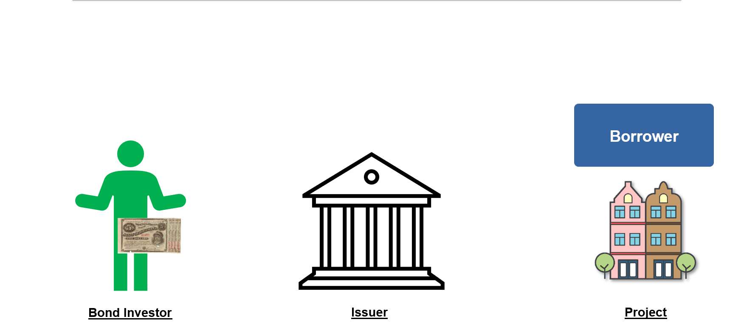
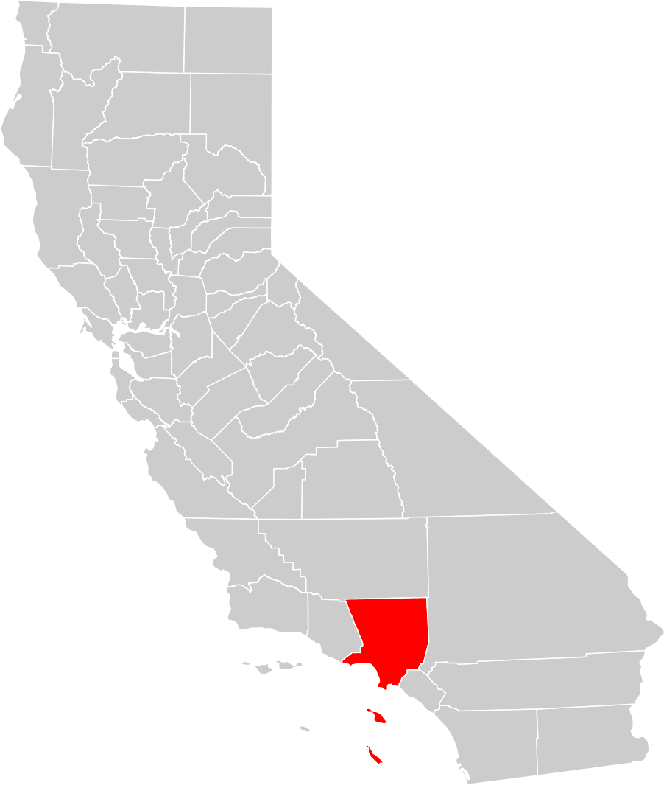










What are Tax-Exempt Municipal Bonds?
When an investor purchases a Tax-Exempt Municipal Bond, they are lending funds to the Issuer
Municipal Bonds are debt instruments used by State, Local and City Governments to raise money for projects like roads, schools, and housing projects
Municipal Bonds are debt instruments used by State, Local and City Governments to raise money for projects like roads, schools, and housing projects
Municipal Bonds are debt instruments used by State, Local and City Governments to raise money for projects like roads, schools, and housing projects
Municipal Bonds are debt instruments used by State, Local and City Governments to raise money for projects like roads, schools, and housing projects
Municipal Bonds are debt instruments used by State, Local and City Governments to raise money for projects like roads, schools, and housing projects
The Issuer then lends these funds to the Borrower to finance the Project
Borrower
Bond Investor
Issuer
Project
Copyright © 2023 Tiber Hudson LLC

Slide 25
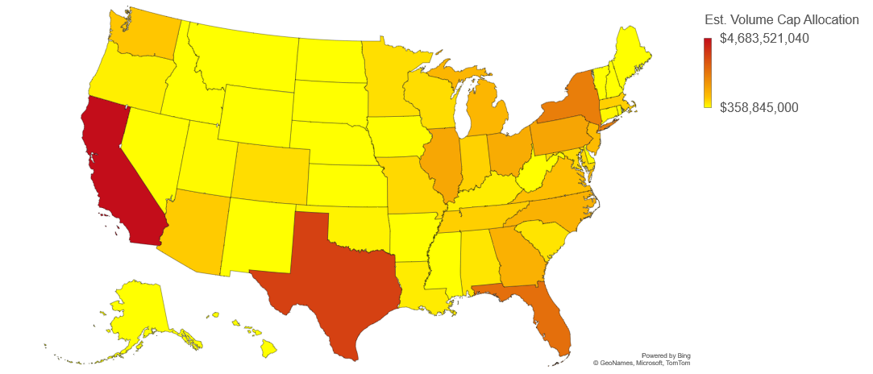
Private Activity Volume Cap Allocation By State
  2023 Volume Cap: $120 per capita or $358,845,000 minimum for small states.
Michigan
Population: 10,050,811
Est. Allocation: $1.2B
Private Activity Volume Cap is allocated by the IRS on a state-by-state basis to provide funding for infrastructure and housing projects, schools, hospitals, and more
Rhode Island
Population: 1,095,610
Est. Allocation: $358M
  2023 Volume Cap: $120 per capita or $358,845,000 minimum for small states.
California
Population: 39,237,836
Est. Allocation: $4.7B
South Carolina
Population: 5,190,705
Est. Allocation: $633M
Texas
Population: 29,527,941
Est. Allocation: $3.6B
Copyright © 2023 Tiber Hudson LLC

Slide 26
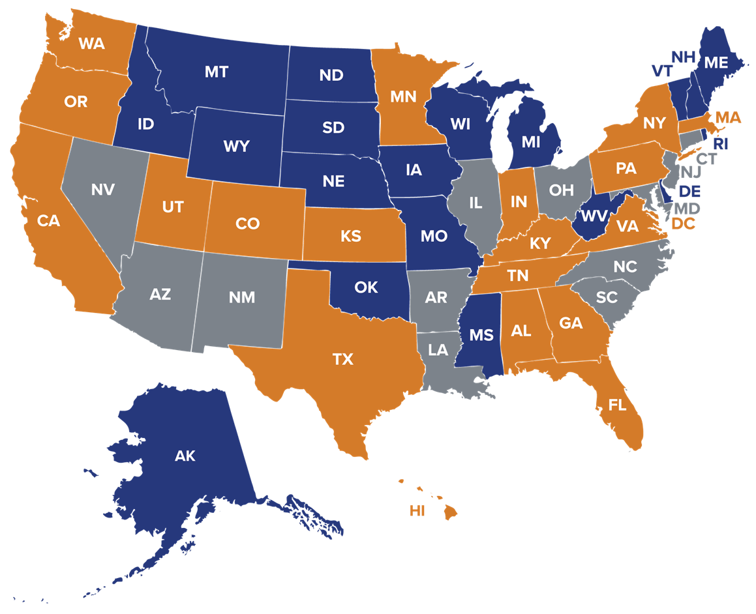

Multifamily Volume Cap Scarcity
Undersubscribed (19 states)
Parity (12 states)
Oversubscribed (19 states &
Washington, D.C.)
Information as of October 2023
Source: Tiber Hudson; Novogradac
Copyright © 2023 Tiber Hudson LLC

Slide 27
Non-LIHTC Debt Options
501c3 Bonds
Essential Function Bonds
Recycled Bonds
Workforce Housing
Taxable Bonds (can also be used with 9% deals)

Slide 28
Contact Information
Lauren Marcus, Esq.
Tiber Hudson
Direct: (202) 973-0122
lauren@tiberhudson.com
John Sabatier
Stifel, Nicolaus & Co.
Direct: (504) 210-3110
sabatierj@stifel.com
Notes:
28

