Slide 1
Dallas Economic Development Corporation
Why is Housing a critical part of Economic Development
OCTOBER 2024

Slide 2
DALLAS IS THE EPICENTER OF BUSINESS
Top of the Texas Triangle with a diverse economy
Home to 68 of the 150 largest public companies in the region which generate $474B in revenue
Home to 1 Fortune 10 Company
11 Fortune 500 companies
22 Fortune 1000 companies
34 of those companies produce over $1B in revenue annually
Top 3 economy in the country surpassing Chicago
Magnet for innovation and talent
Home of ARPH-H- Advanced Research Projects Agency –Customer Experience Hub
Verily HQ relocated to Dallas from San Francisco
Koya HQ relocated to Dallas from California
Texas Stock Exchange
Goldman Sachs campus
Footlocker Tech Hub

Slide 3
DALLAS IS THE CAPITAL OF CAPITAL

Slide 4
Dallas Economic Development Corporation (DEDC)
Created by the City of Dallas in 2022
Independent Non-Profit Organization – IRS designation as a 501 ( c ) 3 applied
Governed by a 15 member Board of Directors which is approved by Dallas City Council
DEDC operates under an Interlocal Agreement with the City of Dallas
City initially seed funded DEDC with $7MM
CEO hired July 1, 2024
Notes:
Why was the DEDC created- There was no organization outside of the City Office of Economic Development that was promoting and marketing the City of Dallas as the preferred location. Each of our neighboring cities had their own EDCs and some of them benefited from available sales tax for investment in incentives and quality of life improvements. Dallas does not have that availability since we invest our sales tax % in transportation through DART.
The growth of jobs and business is essential to the city’s ability to continue to provide services to its residents – both investment in infrastructure and police and fire services.

Slide 5
STRATEGIC FRAMEWORK
OUR MISSION
Promote Dallas as a globally competitive business destination that fosters economic opportunities for all members of the city.
GUIDING PRINCIPLES
Investment and Growth
Globally Competitive
Inclusive and Equitable
Stewardship
STRATEGIC INITIATIVES
Business Development and Marketing
Revenue Generation
Real Estate and Development

Slide 6
FOUR GUIDING PRINCIPALS
Investment and Growth
Drive investment and economic growth through job creation as well as business development and real estate development
Globally Competitive
Position the City of Dallas as the globally competitive destination for business.
Inclusive and Equitable
Prioritize actions and investments that create access to economic opportunity for all.
Stewardship
Strategically manage investments in the DEDC to ensure economic benefits for the City of Dallas

Slide 7
AUTHORIZED FUNCTIONS
PUBLIC DEVELOPER
▸ Public development: serve as a public developer of City-owned properties and conduct land acquisition to advance real estate projects that the City could not do on its own, especially in strategic areas – Public development can be done with other entities
▸ Existing asset support: to support major development projects (e.g., Kay Bailey Hutchison Convention Center, Dallas Executive Airport, he Streetcar project, and Hensley Field)
▸ Transaction Support: perform real estate transactions (lease, sale, purchase)
▸ Lease administration: manage properties on behalf of the City
*Note: Public developer activities on city property are subject to council approval of an amendment to the ILA
BUSINESS DEVELOPMENT
▸ Outbound marketing: marketing missions-domestically and internationally, national awareness campaigns, conferences. Hosting international delegations.
▸ Inbound marketing: familiarization tours, networking with site selectors, real estate brokers and developers as well as existing businesses located in Dallas seeking to expand
▸ Branding: strengthening Dallas’s brand as the global epicenter of business
▸ Business retention & expansion: business visitations, networking, and events. Working with other institutions to ensure adequate and trained workforce for industry clusters.
Notes:
Function as the public developer is unique to Dallas – only Rally Austin and the Houston Partnership do this explicitly. Other EDCs can do it but it is not their primary role.

Slide 8
Dallas-Fort Worth soon to be the 3rd largest economy in the U.S. surpassing Chicago
2024 Dallas Population 1,356,479
2024 DFW Population 8,481,512
2030 Dallas- Fort Worth 10,000,000
Average influx of people to the region is 170,000+ people a year

Slide 9
DFW Employment Trends
DFW Target Industries- Sample
2024 jobs in target industries with Median Income of less than $100,000 1,073,073
2024 jobs in target industries with Median Income of over $100,000 179,512
Hospitality Industry
2024 jobs in the hospitality industry - Average Salary $55,000 1,220,770
Notes:
Dallas Regional Chamber Economic Development Guide- Target industries do not include Hospitality which makes up about 28% of our employment base

Slide 10
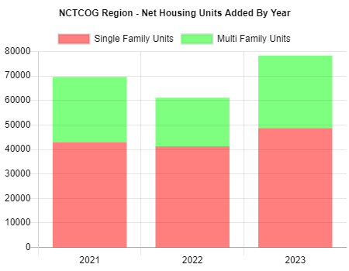
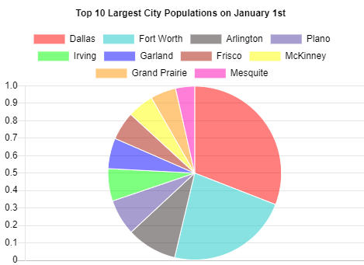
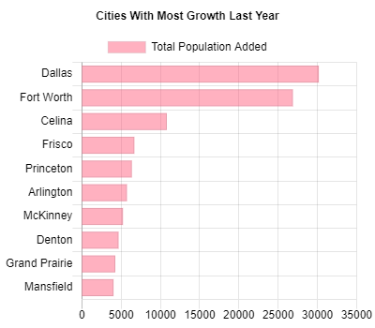
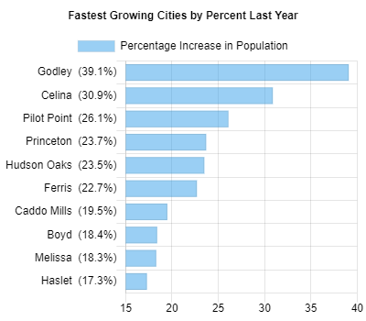
Dallas – Fort Worth by the Numbers
Notes:
Regional growth – adding 170,000 people to the region – single family net new housing units added is less than 50,000 and multi-family housing units less than 30,000. The city built almost as many units in the 2000s (61,900 units) and the 2010s (71,000 units) but added 10 times as many residents in the 2010s (more than 100,000 residents versus less than 10,000 in the 2000s).

Slide 11
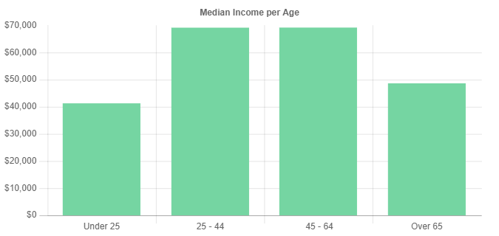
Median Income not keeping pace with cost of housing
The average annual household income in Dallas is $102,023, while the median household income sits at $63,985 per year.

Slide 12
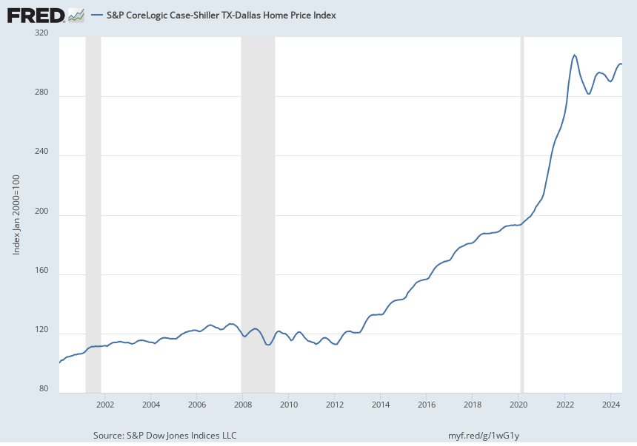
Single Family Housing Price Index
Notes:
Dallas home prices have increased from less than $100,000 in 2002 to over $300K in 2024. Median Home prices were 1.4X median income and now are almost 5X median incomes. We have had 4 recessions since 1989 – in the 90’s it was created by the bust in the oil and gas business as well as real estate. Then in 2001 – 9/11 occurred and then in 2008 – 2009 we had the financial crisis. Other impactful events that impacted housing production.
While we had a housing shortage before the pandemic – a lot of small builders went out of business in 2020 which has impacted supply.

Slide 13
High Housing Costs| Mirroring national trends, rents began stabilizing in 2022 after steadily increasing over the last decade and rapidly increasing during the pandemic. While rent growth has slowed, rents remain high, and wage growth has not kept pace.
City of Dallas Mean¹ Rents and Rents affordable to Median Renter
(2015-2024)
Rents increased more in Dallas in the 2.5 years after the start of the pandemic than in the 6 years before the pandemic.
Beginning in 2022 rents started to stabilize. Annual rent growth declined from +17.3% in February 2022 to -0.5% in September 2023 when rents briefly decreased. By January 2024, annual growth rate was only +0.3%.
Mar 2020 to Dec 2022:
+24% (+$334)
Dec 2022 to Jan 2024:
+0.3% (+$5)
$2,000
Mar 2015 to Mar 2020:
+22% (+$253)
The gap between the rent affordable to the median renter and the mean rent was $463 in Dec 2022, up from $276 in 2015 (+74%). By January 2024, the projected gap declined to $296*.
$1,500
$1,000
Gap
Rent Affordable for Median Renter Mean Rent
$500
While incomes have increased steadily, they have not kept up with rent increases. Between 2016-2022, incomes grew +46% while rents grew +52%.
$0
1. To provide the most accurate and recent estimates, average rent data is sourced from Zillow through the Zillow Observed Rent Index (ZORI) which is a weighted average rent index of observed rent changes on properties tracked over time. Median renter income data is sourced from the American Community Survey. *Census data for 2023 and 2024 have not yet been released, so median incomes for these years are projected based on historic trends.
2015
2016
2017
2018
2019
2020
2021
2022
2023
2024
Source(s): ACS 2022 B25119: Median Household Income by Tenure, Zillow Observed Rent Index (ZORI).
Dallas Rental Housing Needs Assessment | HR&A and CPAL

Slide 14
The rental housing supply gap will begin to affect higher income households, with a gap of 62,747 units for households earning up to 80% of AMI.
City of Dallas Projected Housing Supply Gap
2035 (projected)
83,496
76,073
62,747
34,869
14,433
≤30% AMI ≤50% AMI ≤60% AMI
City of Dallas Projected Housing Supply Gap
2035 (projected)
Units affordable per 100 Households by AMI
≤80% AMI
≤100% AMI
94
66
24
34
18
≤30% AMI
≤50% AMI
≤60% AMI ≤80% AMI
≤100% AMI
Note: The projected rental housing supply gap at 80% AMI increased relative to last year’s report, which cited 23,300-unit gap by 2030. Source(s): State of Texas (TEPP) Projections, ACS PUMS 2022, HR&A Calculations.
Dallas Rental Housing Needs Assessment | HR&A and CPAL
19
Notes:
The Housing gap will increase to over 76,000 units in Dallas for those at 50% or less of AMI by 2035

Slide 15
Why housing is a critical part of Economic Development
Access to affordable housing allows businesses to have access to a reliable workforce. Additionally, housing affordability at all income levels can support a talent attraction strategy.
Mixed-income developments reduce poverty concentration and allow for more opportunities for community diversity.
New developments are usually in underutilized areas that may be blighted or low density. Building new housing, especially in mixed-use, mixed-income developments, increases the value of the property and the tax base of the community.
Affordable housing at all income levels means that residents have more disposable income which can be spent on local businesses and services. This means more money flowing through the community and in turn more business tax revenue for the community.

Slide 16
Economic Development Tools - Housing
Comprehensive Urban Planning – FORWARD DALLAS
Zoning Reform
Parking Incentives
Tax Increment Financing Districts
Encourage Density
Utilize publicly owned land
Notes:
Forward Dallas land use study complete after a two year public process. This land use plan will replace the last one done by the City of Dallas in 2006. This recognizes issues of equity – with toxic industrial uses historically close to low income residential neighborhoods. It also reviewed all areas to ensure that we capitalized on areas with mixed use developments. The City of Dallas (38%) owner-occupied units and 302,572 (52%) renter-occupied units. The remaining units are vacant. 90% of owner-occupied units in Dallas are single-family homes.
Zoning reform will follow the land use plan but it will only impact areas that are not in planned development districts – also known as PDs- Dallas has over 1100 PDs.
Parking and zoning are the enemy of affordable housing.

Slide 17
DEDC STRATEGIC INITIATIVES
Goal 1 Business Development and Marketing
Develop a city-centric business attraction and marketing strategy in coordination with the Office of Economic Development and the Racial Equity Plan to grow the tax base and create economic opportunity through job creation across the city.
Goal 2 Revenue Generation
Leverage a future real estate portfolio to generate new revenue streams such as transaction fees, city asset management, or revenue from the tenants of real estate development projects.
Goal 3 Real Estate and Development
Strategically pursue real estate projects – with the City or with other governmental entities
Leverage initiatives within the City of Dallas to identify transformative real estate opportunities.

Slide 18
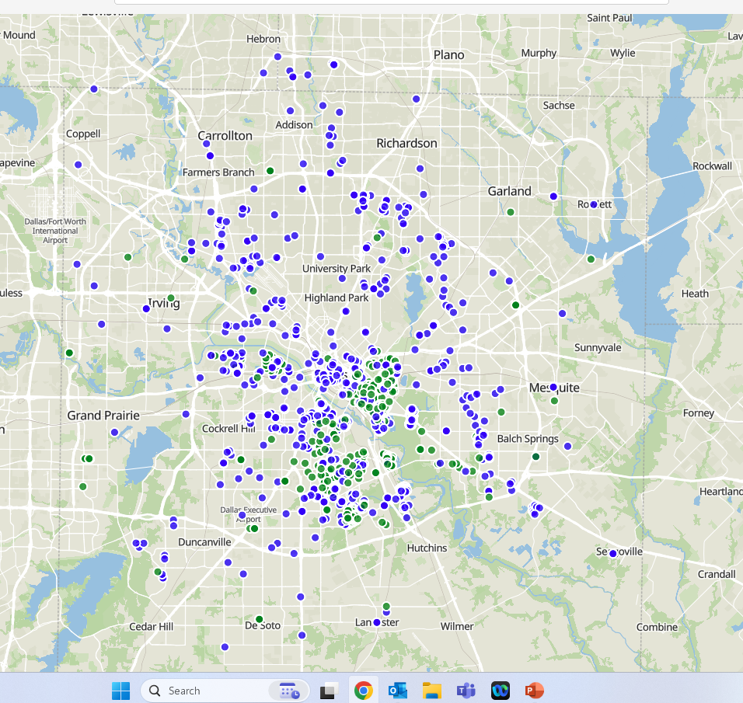
Real Estate Development Opportunities
Notes:
This is just some of the land that is owned by the City of Dallas. It does not include park land or faculties for police and fire as well as the trinity watershed. This is our opportunity.

Slide 19
Linda McMahon
CEO
Dallas Economic Development Corporation
www.Dallasedc.com
Lmcmahon@Dallasedc.com

