Slide 1
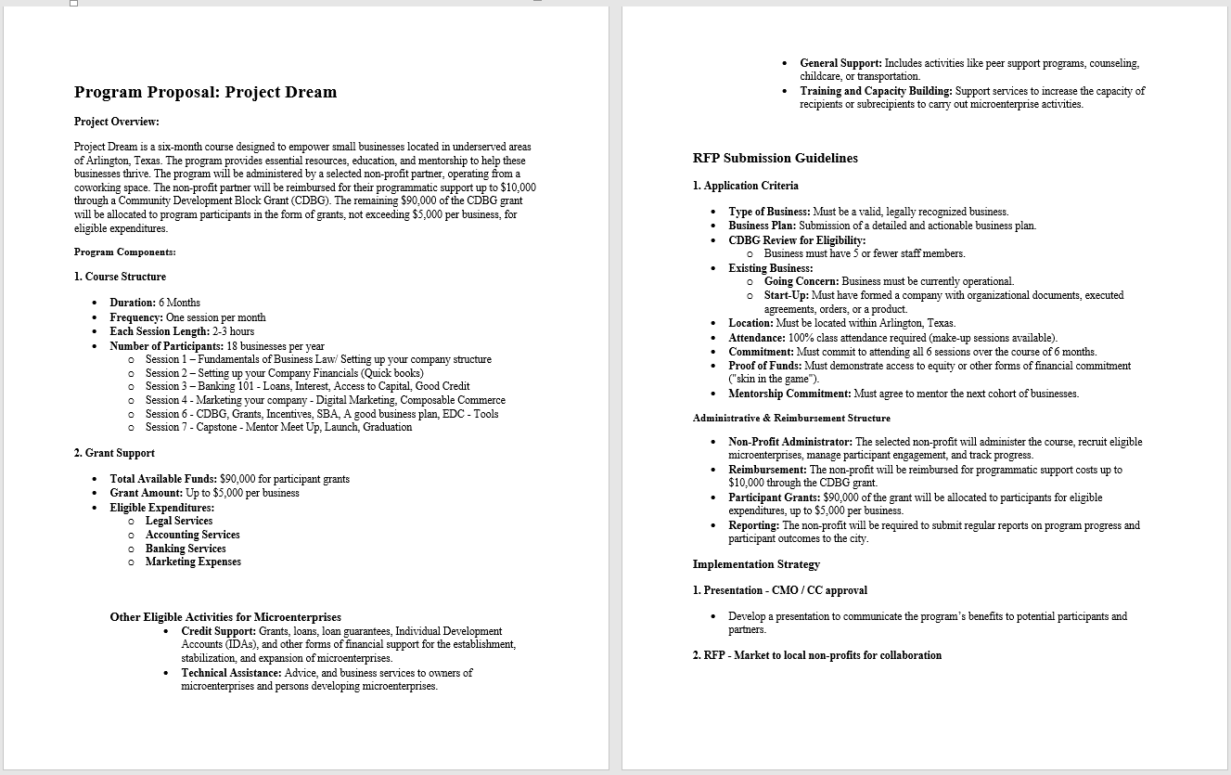
Program Outline
Building An Ecosystem
Small Business Support
  Micro-enterprises
  Up to $5,000 per business for qualified expenditure.
6 Month Cohorts
  Multiple areas of support (including score, SBA, lift etc.)
  Entrepreneurial managed / supported
  Foundational support
Targeted Areas
  Park Row & New York
  Felder and Sandford
  International Corridor
Administration
  Public / Private Partnership
  RFP / Non-Profit administrator
  Up to $10,000 Admin
Criteria
  Located in targeted area, proof of equity, mentorship requirements, etc.
  100% participation
  Other

Slide 2

Addressing Poverty and Homelessness
How do we decide the target areas
Factors to Consider
Housing Precarity Risk: a composite score of eviction risk, displacement vulnerability, and pandemic unemployment.
Eviction Risk: composite score for the top variables that relate to eviction lockouts. This estimate does not account for eviction notices and filings and therefore is a conservative estimate of eviction risk.
Displacement Vulnerability: location of communities with predominantly low-income households and/or ongoing displacement. Predominantly low-income households are also susceptible to displacement depending on local housing markets. Also, low-income displacement often precedes gentrification.
2020 Unemployment: Estimated unemployment during the pandemic
Change in Unemployment from 2019 to 2020
Segregation: Neighborhood level typology showing which racial groups share of the population is greater than 10%.
Introduction
The COVID-19 recession featured massive unemployment among low-wage workers, exacerbating already precarious housing conditions and putting millions more at risk of losing their homes. As the United States enters recovery and federal and local eviction moratoria near their end, it is unclear how many households will face eviction, displacement, or even homelessness. Therefore, it is important to understand who and where vulnerable groups live so that assistance can be directed appropriately.
To help understand the extent of housing precariousness in the U.S., the Urban Displacement Project was funded by C3.AI to build the Housing Precarity Risk Model (HPRM). Precarity, defined as resilience to economic and environmental shocks (Pendall et al, 2012), is measured as a composite score of pre-pandemic low-income concentrations, low-income displacement and eviction lockout risk interacted with 2020 unemployment and COVID-19 infections. Our primary goal is to identify the most vulnerable neighborhoods (i.e. US Census tracts) that are in particularly urgent need of assistance and resources from local, state, and federal agencies. We also provide anti-displacement policy recommendations below.
Housing Precarity Risk Model – Urban Displacement

Slide 3
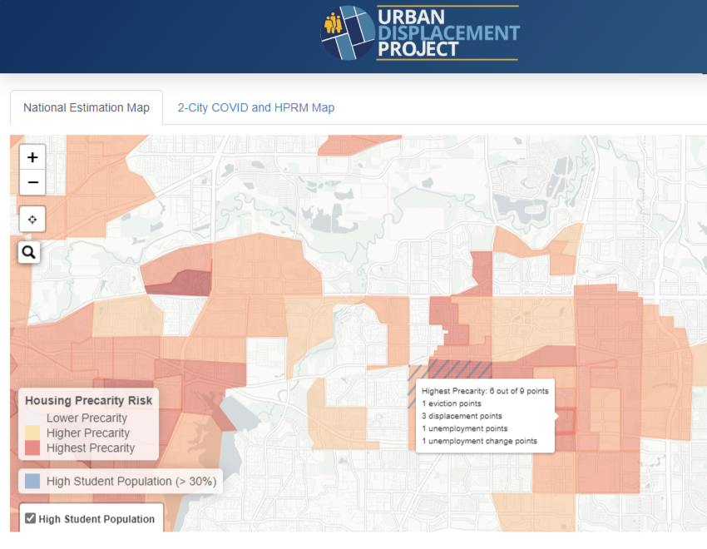
PRECARITY
Holistic Approach – We decide
Employment / Entrepreneurship
  INCOME INSECURITY
  EMPLOYMENT INSECURITY
Training
  EDUCATION
  TECHNICAL SKILLS
Incentives
  CDBG
  TIRZ
  EDC / CITY
Housing
  AFFORDABLE
  ACCESSIBLE
Transportation
  MOBILITY
  MASS TRANSIT OPTION
  JOB ACCESSIBILTY
Lake Arlington

Slide 4
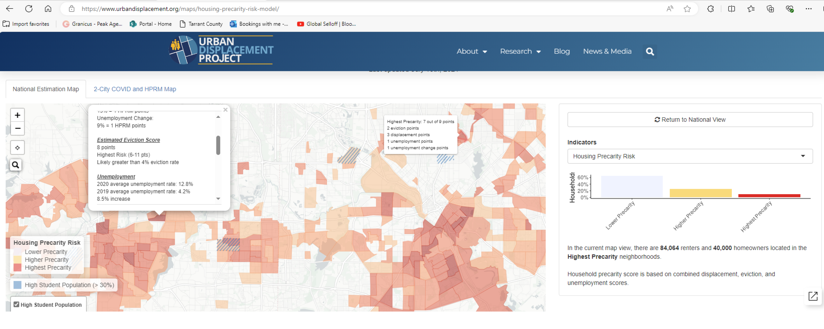
Lake Arlington

Slide 5
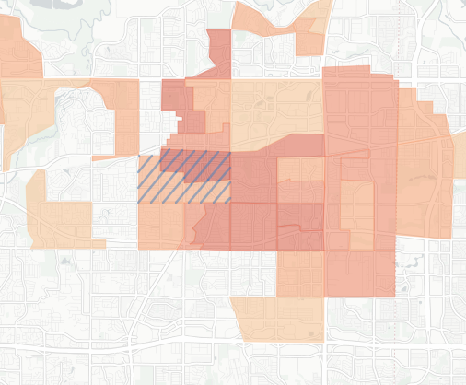
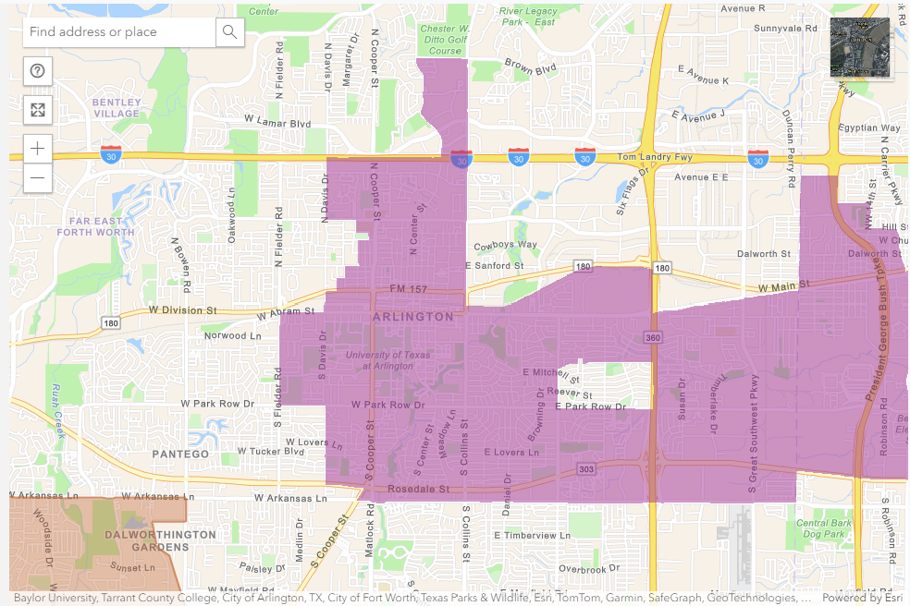
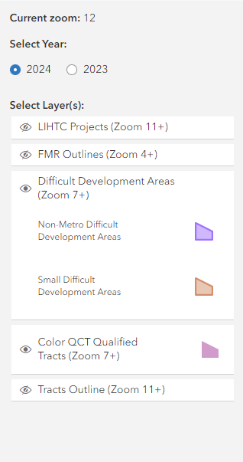

HUD Data Comparison
Low-Income Housing Tax Credit Qualified Census Tracts must have 50 percent of households with incomes below 60 percent of the Area Median Gross Income (AMGI) or have a poverty rate of 25 percent or more.
QCT Criteria HUD Website

Slide 6
Building an Ecosystem
Start-Up Support
  Incubators & Accelerators: Mentorship, resources, real estate, et al.
  Community Networks: Collaboration and idea sharing.
Business Management
  Training & Development: Skills in management and operations.
  Regulatory Guidance: Navigating permits, licenses, and incentives.
Commercialization
  R&D Partnerships: Innovate and commercialize products and services.
  IP Support: Protecting and monetizing intellectual property.
Access to Capital
  Funding: Venture capital, grants, and crowdfunding.
  Financial Institutions: Loans and financial products.
  Micro Loans / RLF – Lift Fund
Scaling & Growth
  Market Expansion: Domestic and international strategies.
  Growth Funding: Series B, C, and private equity.
  Global Reach: Trade partnerships and export assistance.
Desired Outcomes
Economic Growth
  Job creation and GDP contribution.
Community Development
  Local revitalization and inclusivity.
Global Competitiveness
  Building a hub with formidable reputation.
Notes:
For your notes:
SBA's SCORE program provides entrepreneurs with high-quality, personalized guidance through a vast network of volunteer mentors, including retired executives and experienced business owners. These volunteers offer tailored advice on critical areas such as business planning, financial management, marketing, and operations. SCORE's support is widely respected for its practical, real-world insights, making it a valuable resource in both the Start-Up Support and Business Management categories. By leveraging the diverse expertise of its volunteers, SCORE helps entrepreneurs refine their strategies and make informed decisions, significantly boosting their chances of success.
LiftFund, a CDFI nonprofit lender, is a partner with the City of Arlington, Texas, offering zero percent interest loans of up to $50,000 for small businesses. This initiative is designed to provide critical financial support for activities like purchasing equipment and managing payroll, particularly benefiting minority-owned businesses that often face barriers to traditional financing (operating capital and fixed assets). This partnership is a key resource in the Access to Capital category, ensuring that small businesses in Arlington have the financial tools they need to stabilize and grow
References: https://www.kauffman.org/currents/growing-local-economies-by-scaling-entrepreneurship/
Case Studies:
Michigan Economic Development Corporation: https://www.michiganbusiness.org/services/small-business/
Abilene, Texas: https://developabilene.com/why-abilene-texas/abilene-small-business-and-entrepreneurs/
Brownsville, Texas: https://ebridgecenter.com

Slide 7
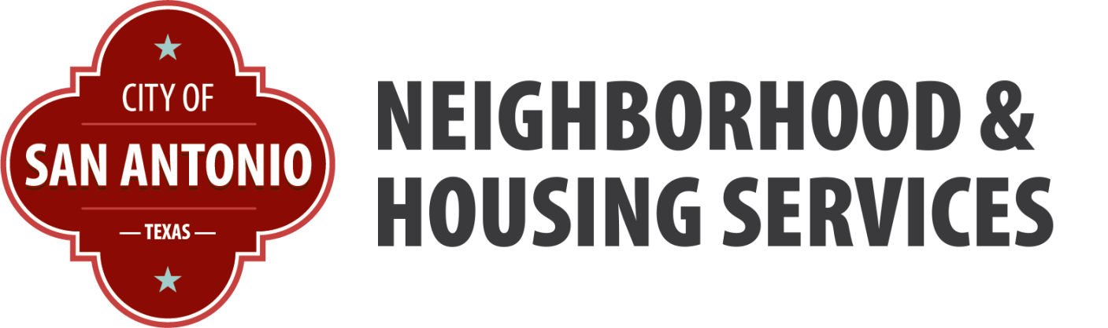
Chicken or the Egg: Which Comes First?
Housing or Economic Development!
Ian Benavidez, Deputy Director

Slide 8
City of San Antonio – Programs and Incentives
8
  Neighborhood & Housing Services
  Location, affordability, type of development
    Home repair (major/minor)
    Gap funding (HOME/CDBG/Bond)
    Fee Waivers (City & SAWS)
    Tax Increment Reinvestment Zones (TIRZ)
    Brownfields (environmental)
    San Antonio Housing Trust/PFC
    Office of Urban Redevelopment
  Economic Development
  Business size and opportunities, location
    Ch. 312 Tax Abatement
    Ch. 380 Rebates and Economic Development Incentive Fund
    Fee Waivers (City & SAWS)
    Zero Percent Loan Program
    Construction Mitigation
    Growth Company Grant Programs
    Placemaking Programs
    San Antonio Economic Development Corporation (SAEDC)
8

Slide 9

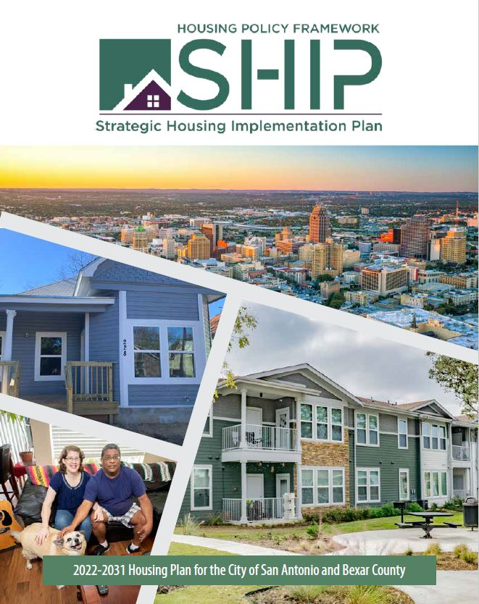
Strategic Housing Implementation Plan
Shared vision for housing affordability & livability
  City, County, Housing Authority, and Housing Trust
New definition of affordability
  60% AMI Rental | 120% AMI Ownership
Production & preservation targets
  28,000 – 10 years
10-year funding outlook
  LIHTC, gap funding, fee waivers
Housing Bond ($150M)
  Home repair, new ownership and rental, rental rehab, PSH
Notes:
We're now in our 3rd year of implementation. A major strength of the SHIP is that it has stayed relevant- quarterly updates to council committee and HC
We made a big commitment to keep reporting to the public. This was on the advice of our process consultant who wisely flagged that if you don't tell the public you did it, then it's as good as you didn't do it.
Annual report
Dashboard
Annual event
Show snap shots of these
In year 5 we will likely do a 'refresh' and so we'll soon start thinking about what that will all entail.

Slide 10
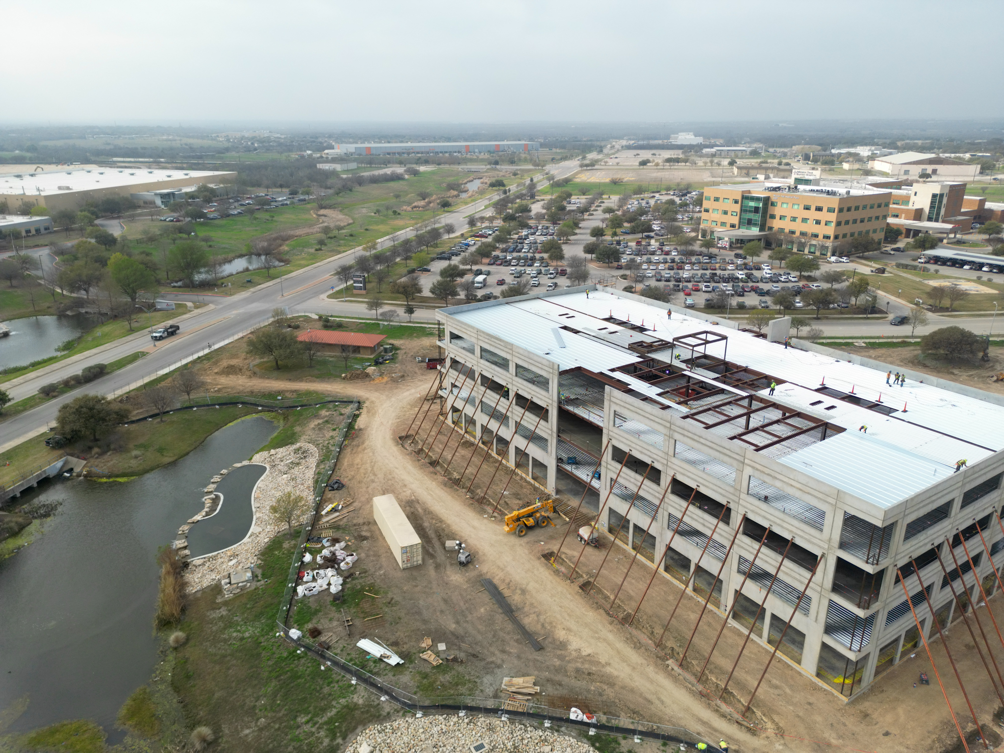
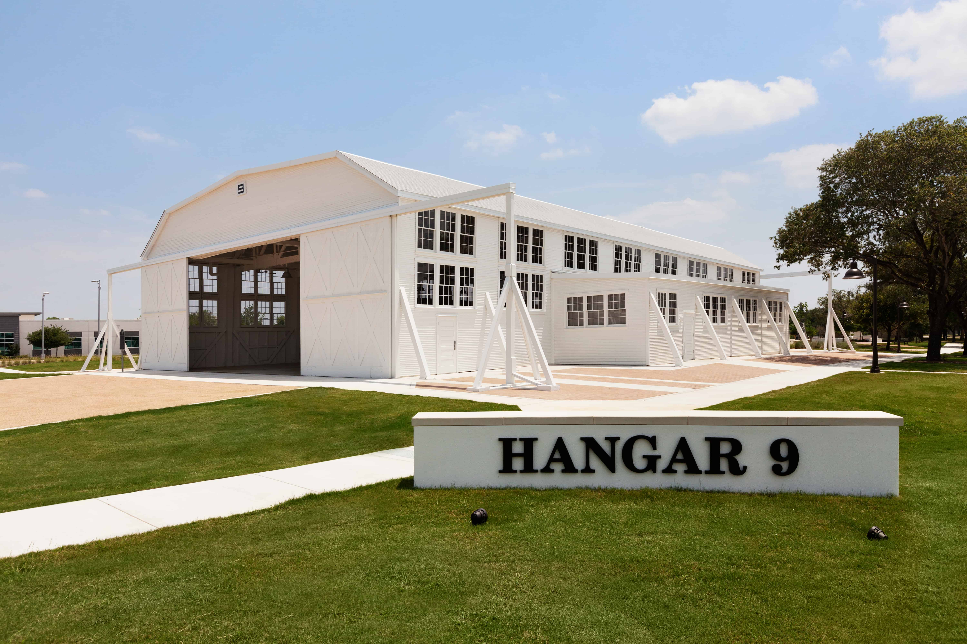
Brooks Redevelopment
Notes:
Decommissioned Air Force Base
Brooks is a 1,308-acre mixed-use community in San Antonio, Texas, owned and managed by the Brooks Development Authority. We are governed by an 11-member board of directors that is appointed by the San Antonio City Council. We are a true public-private partnership. Brooks was created in 2001 by the United States Congress, the State of Texas and the City of San Antonio to redevelop the former Brooks Air Force Base
More than 50 BUSINESSES have made the move to Brooks. With $1.34B in development to date
1,308 Acres
5,300 Employees
federally designated “opportunity zone
TIRZ Created – roads, utilities, infrastructure
4 market rate apartment complexes
2 affordable housing projects underway (SAHT)
500 single-family homes

Slide 11
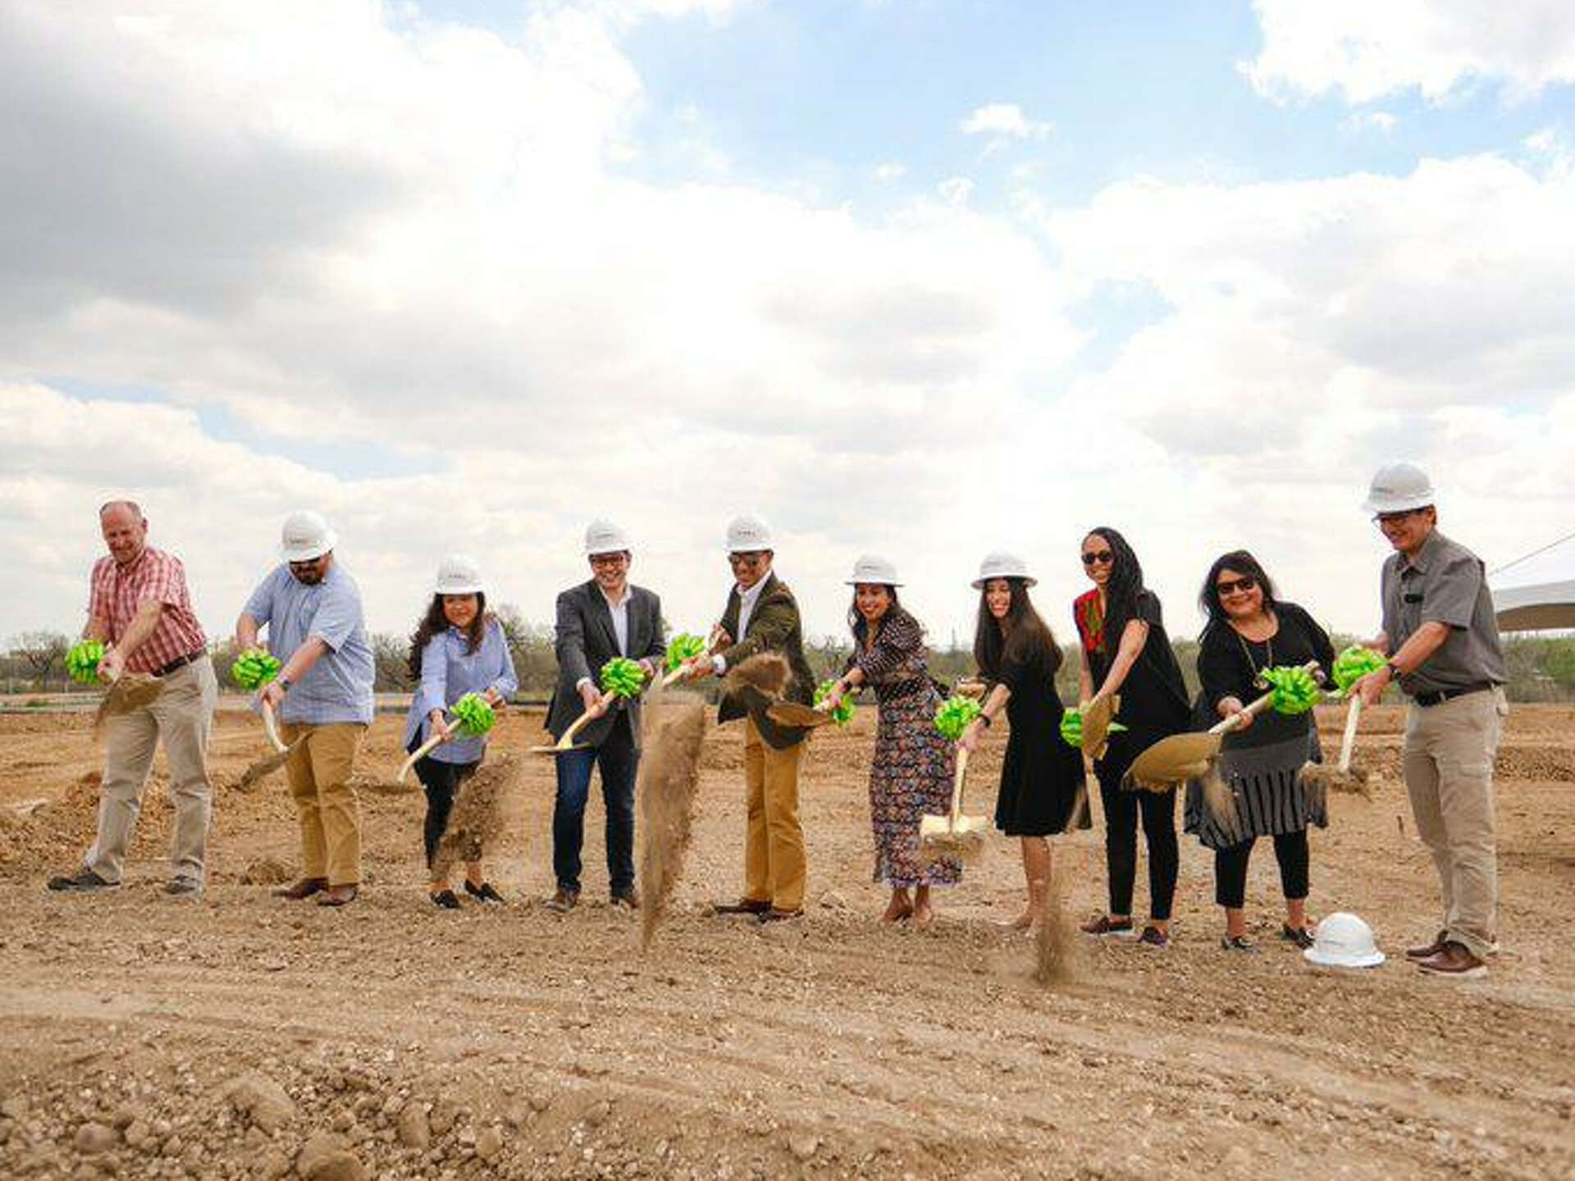
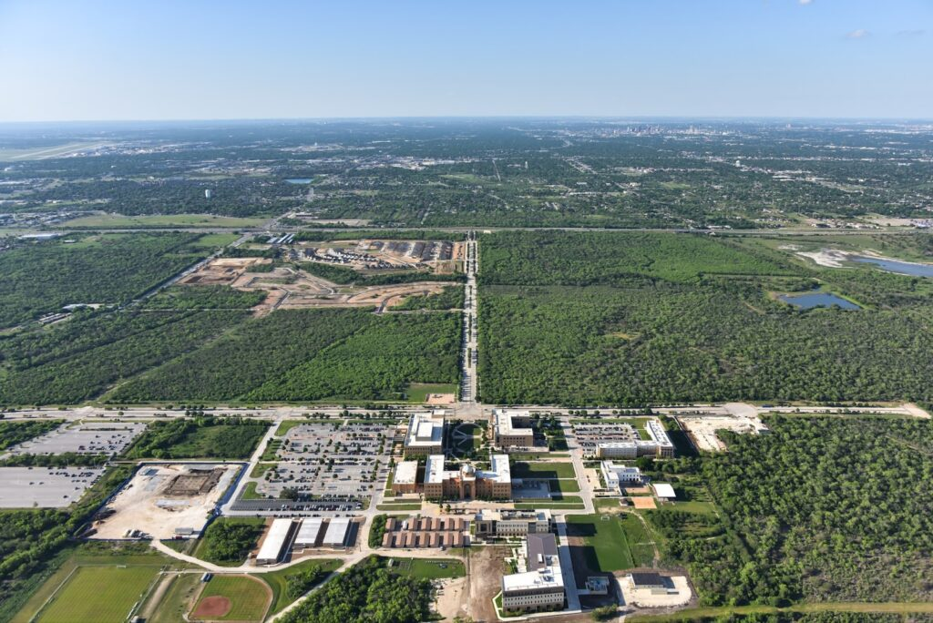
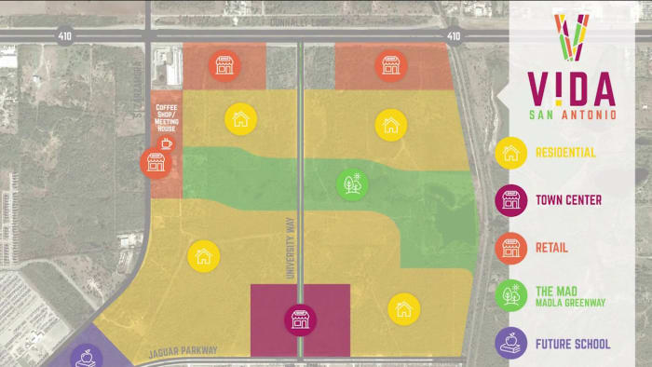
Texas A&M San Antonio - V!DA
11
11
Notes:
TIRZ Funding provided infrastructure for campus and access to adjacent roadways
The project is financed by four percent housing tax credits allocated by the Texas Department of Housing and Community Affairs ($36M); private activity bonds issued by Opportunity Home San Antonio ($38M); COSA 2022 Bond award funds ($2M); COSA HOME federal funds ($2.25M); COSA Neighborhood Stabilization Program (NSP) federal funds (nearly $1M);

Slide 12
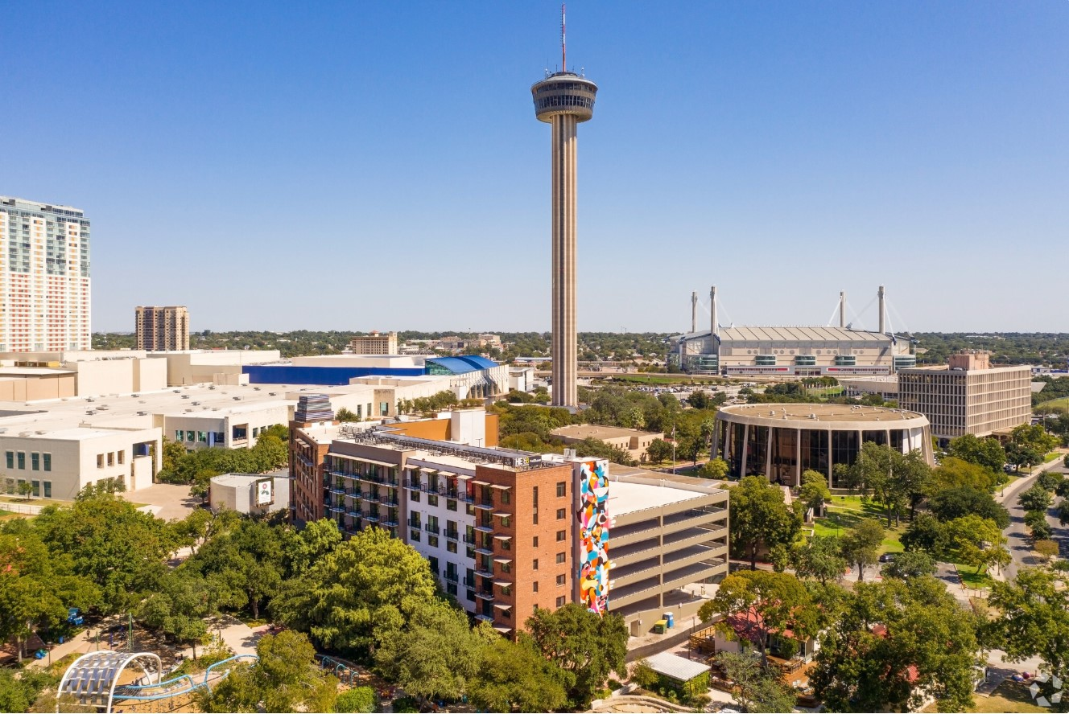

Hemisfair

Slide 13
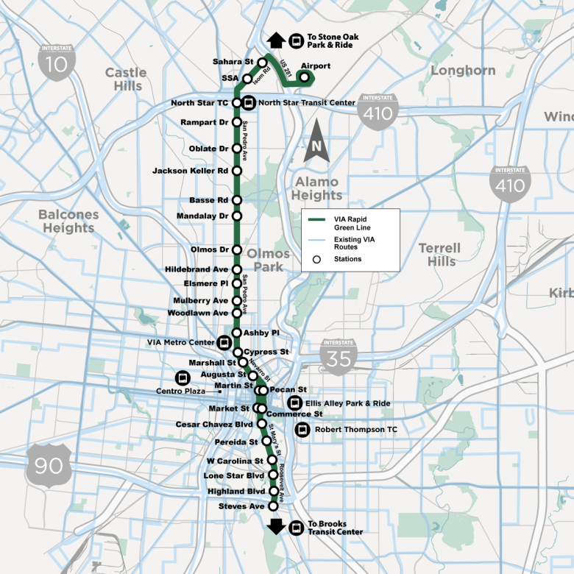
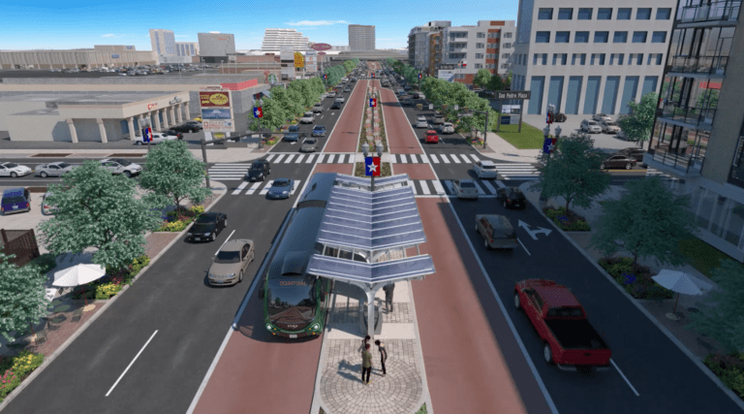
Transit Oriented Development
13
13

Slide 14
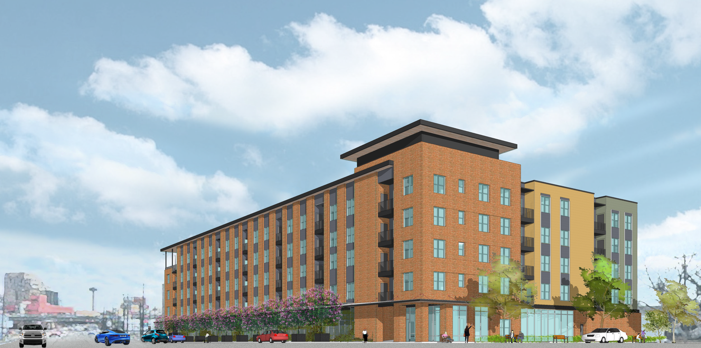
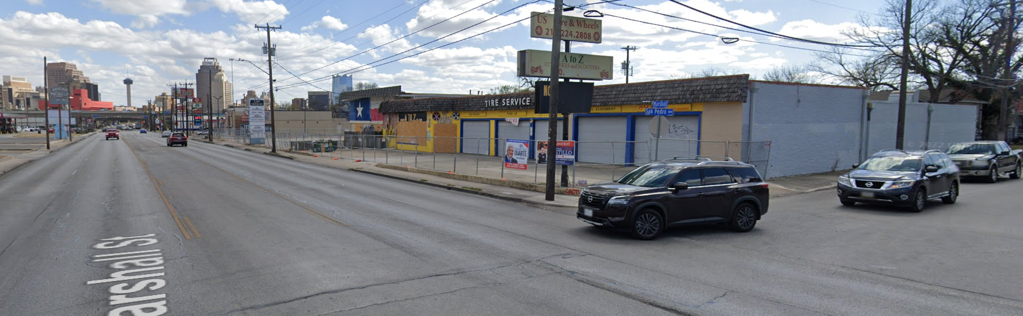
Permanent Supportive Housing

Slide 15
Chicken or the Egg: Which Comes First?
Housing or Economic Development!
Ian Benavidez, Deputy Director

Slide 16
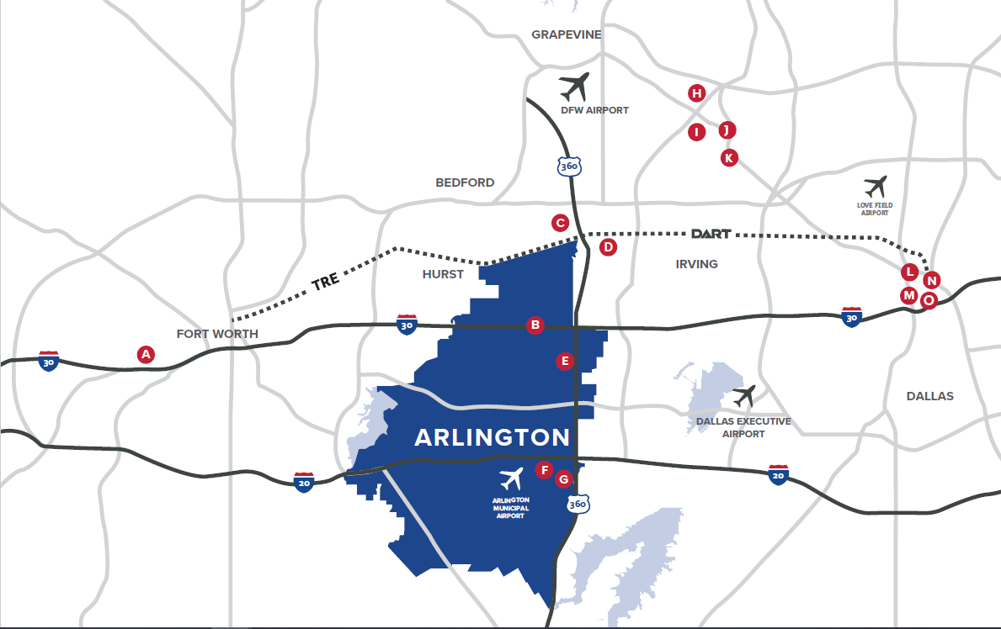
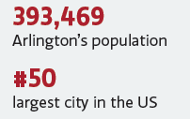
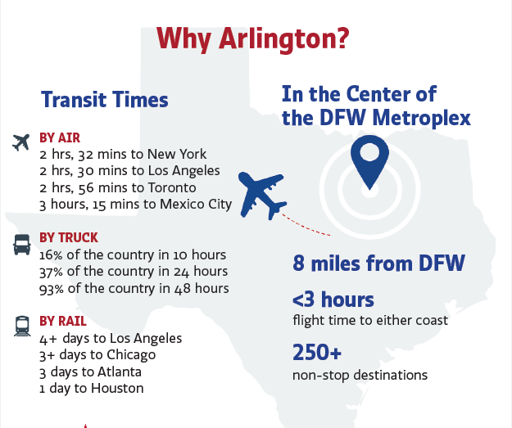
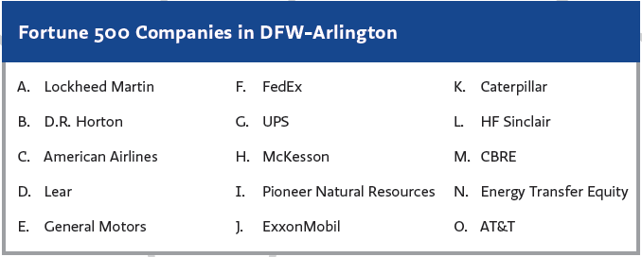

Slide 17
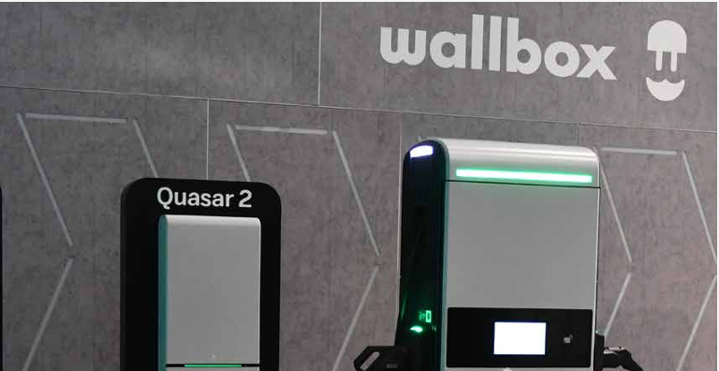

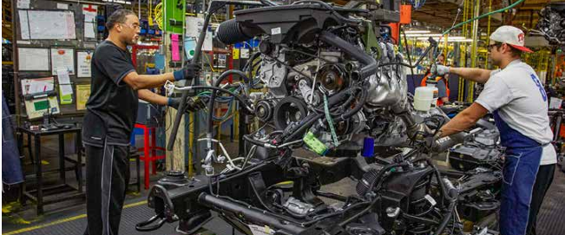
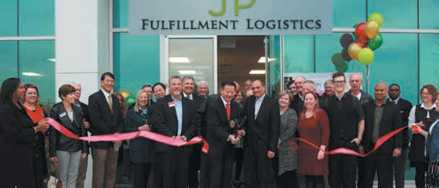
City of Arlington Accolades
#6 Hardest-Working Cities in the U.S. - WalletHub
Top 25 Best Places to Live in Texas - Better Homes HomeCity
#5 Most Diverse Cities in the U.S. - WalletHub
#3 Best Cities to Start a Business in the U.S. - LanternCredit.com
Top 25 Most Fiscally Sound Big Cities in U.S. - Financial State of the Cities (FSOC) surveys
Top 20 Best Cities to Do Business in Texas - HomeCity
Arlington was the first city in Texas to earn the Gold “What Works Cities” Certification by Bloomberg Philanthropies. The City was also the first in Texas to achieve the Silver Certification.
The City of Arlington has a AAA bond rating from Standard & Poor’s and Fitch, as well as AA+ bond rating from Moody’s.

Slide 18
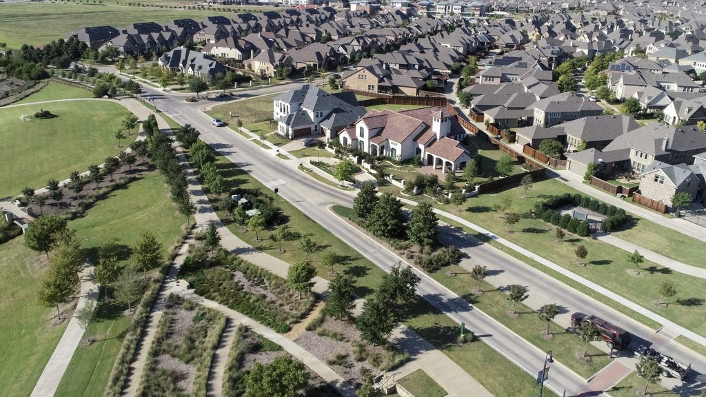

Slide 19
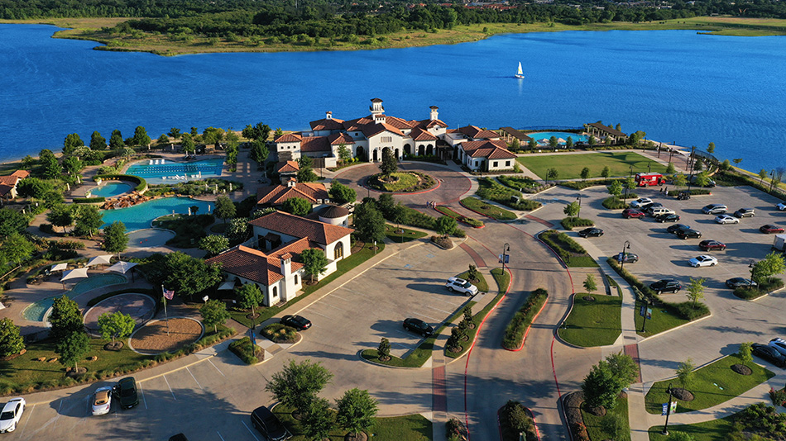

Slide 20
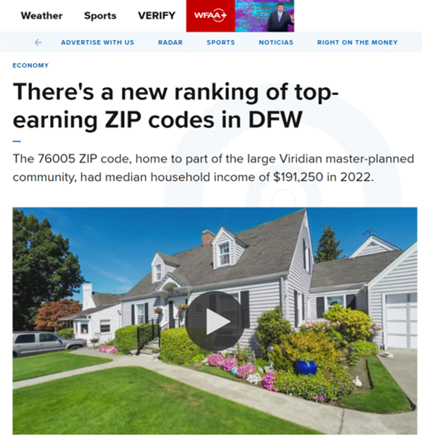

Slide 21
