Slide 1
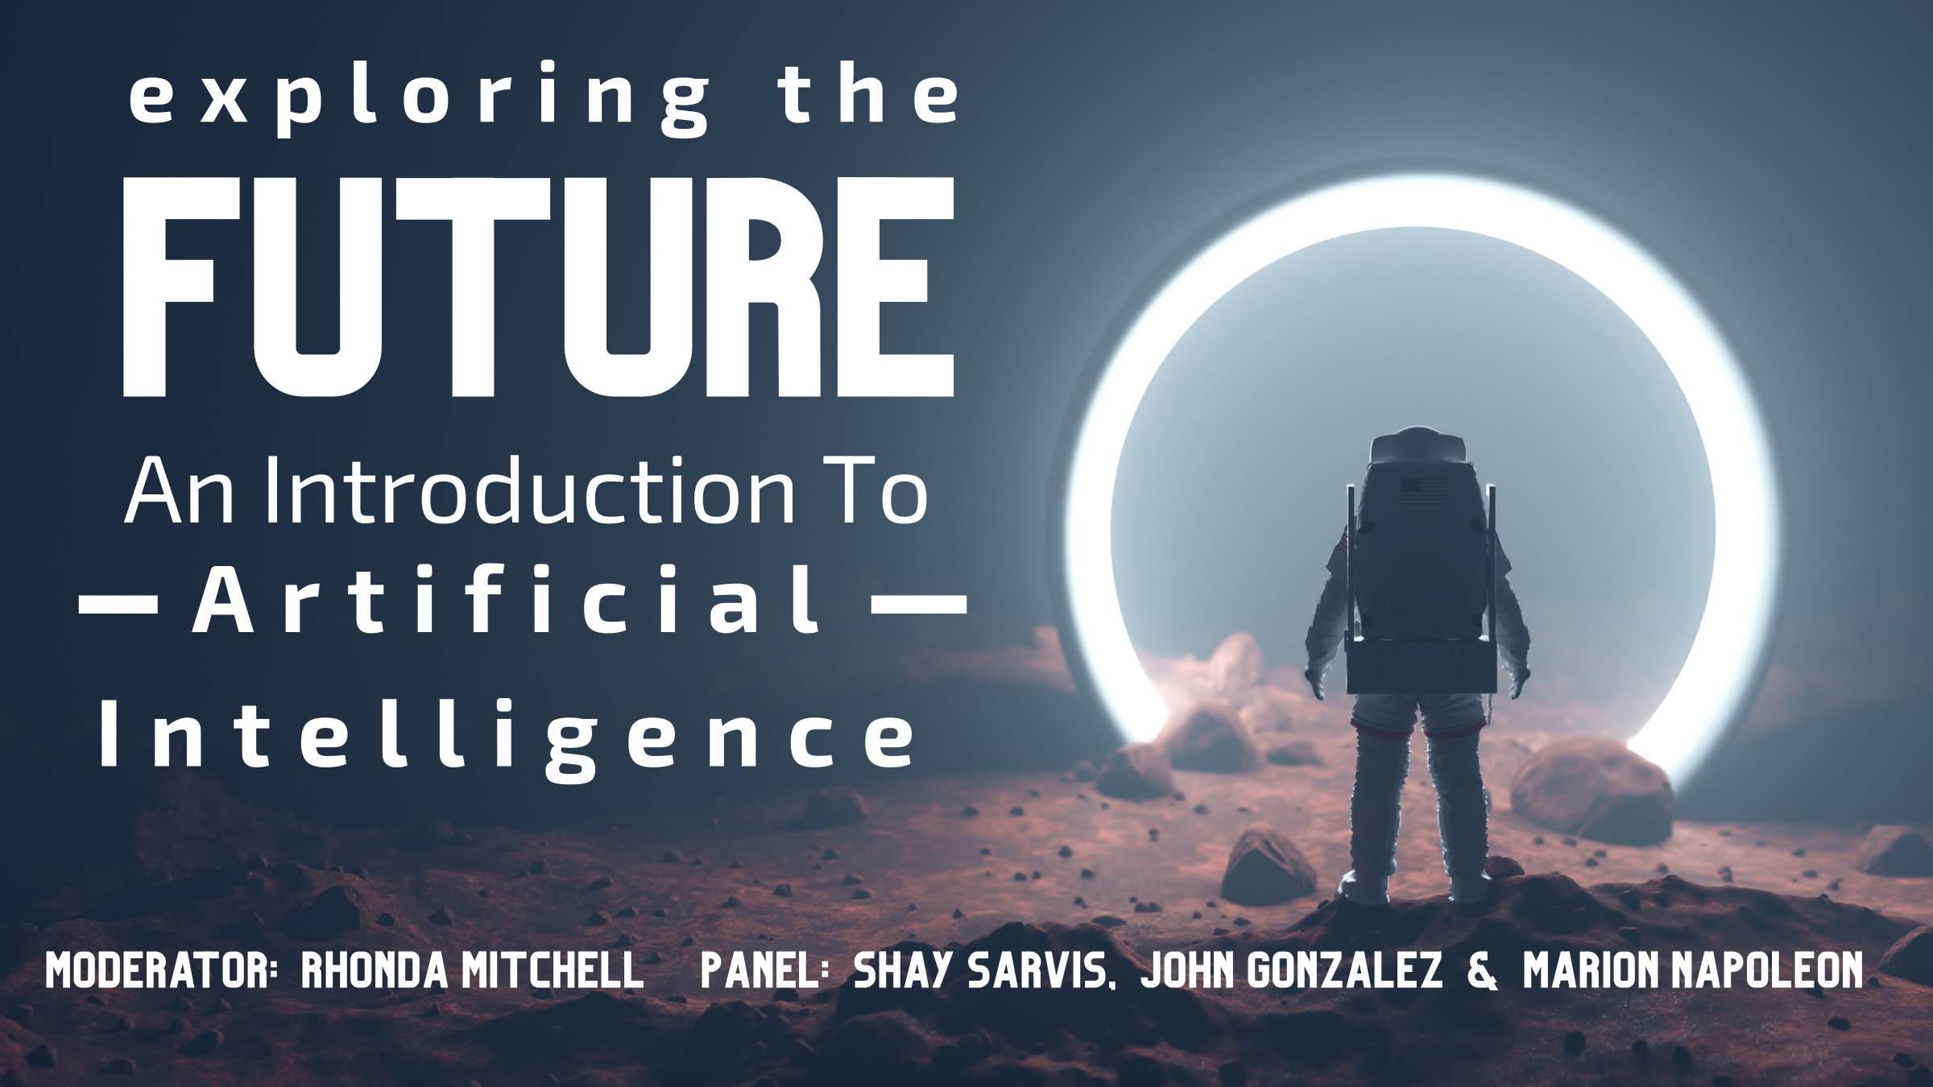

Slide 2



Artificial Intelligence as a Tool
Shay Sarvis
Senior Manager
Yardi Systems, Inc.
www.yardi.com

Slide 3
Agenda
What is AI/Artificial Intelligence?
History of AI for Business
AI Tools Available Today
AI in our Industry

Slide 4

What is AI?
Artificial Intelligence, or AI, is technology that enables computers and machines to simulate human intelligence and problem-solving capabilities.
Artificial Intelligence is the science of making machines that can think like humans. It can do things that are considered “smart”.

Slide 5
What is AI?
AI technology can process large amounts of data in ways, unlike humans.
The goal for AI is to be able to do things such as recognize patterns, make decisions, and judge like humans.
The models can produce accurate insights and predictions and AUTOMATE tasks that typically require human intelligence.

Slide 6
What is AI?
Artificial Intelligence encompasses Machine Learning and Deep Learning.
These disciplines involve the development of AI algorithms, modeled after the decision-making process of the human brain, that can ‘learn’ from available data and make increasingly more accurate classifications or predictions over time.

Slide 7
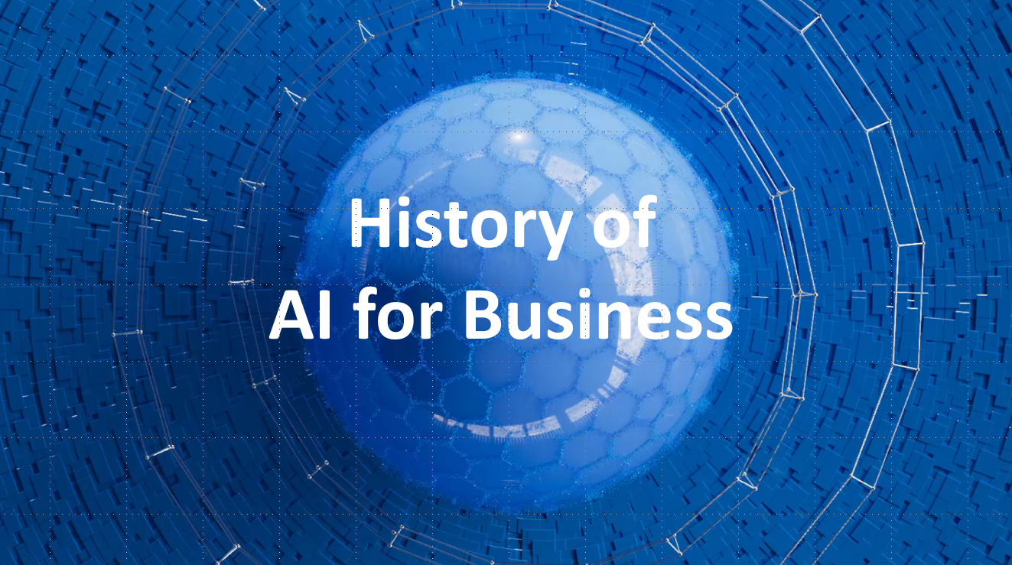

Slide 8
History of AI for Business
1950: Alan Turing published “Computing Machinery and Intelligence” proposing a test as a measure of machine intelligence. “Machines can think.”
1960s and 1970s: Theories, programming languages, and development of early AI learning models.
1980: First conference of the AAAI was held at Stanford University.

Slide 9
History of AI for Business
In the 1990s and early 2000s machine learning was applied to many problems in academia and industry.
The success was due to the availability of powerful computer hardware, the collection of immense data sets, and the application of solid mathematical methods.
Initial product uses were for the Roomba vacuum, Speech Recognition software, Virtual Reality games, NASA robots.

Slide 10
History of AI for Business
Product introductions in the 2010s include Xbox 360, IBM’s Watson, Siri and Cortana, DARPA Robots
In 2012, Deep Learning proved to be a breakthrough technology, eclipsing all other methods.
The Transformer Architecture debuted in 2017 and was used to produce Generative AI applications.
Investment in AI and use has exploded in the 2020s.

Slide 11
History of AI for Business
Reactive Machines – These AI systems react to their environment based on predefined rules. They lack memory and the ability to learn from new data or past experiences.
Examples
  Bank ATM
  Traffic Signals
  IBM Deep Blue (played chess)

Slide 12
History of AI for Business
Limited Memory Machines – this kind of technology enables them to adapt to the behavioral patterns of their past experiences and decisions over time.
Example
  Fraud Detection Systems
  Virtual Assistants
  Spam Filters

Slide 13

AI - POWERED
HUMAN - CENTERED
GPT
NLP
Generative Pre-trained Transformers
Natural Language Processing
LLM
ML
Large Language Models
Machine Learning
Notes:
LOTS of acronyms around the acronym AI ☺
The ones on the right have been around longer and are more widely known… machine learning and natural language processing.
Those on the left are newer, more advanced and more powerful. We’re all now familiar with Chat GPT… well the GPT part is generative pre-trained transformers and LLM stands for large language models.

Slide 14
Machine Learning, ML
A subset of artificial intelligence (AI) that allows systems to learn and improve without being explicitly programmed.
ML uses algorithms to analyze data, learn from the insights, and make decisions. This allows computer systems to continuously adjust and improve themselves based on their experiences.
Example of ML is Self Driving Car technology.

Slide 15
Deep Learning, DL
A Machine Learning technique that uses artificial neural networks (ANNs) to teach computers how to process data in a way that resembles the human brain.
Deep Learning models are trained on large sets of unlabeled data to recognize complex patterns in text, sounds, pictures, and other data.
Examples are CGI used in movies, videos, and images.

Slide 16
Large Language models, LLMs
LLMs use Deep Learning to analyze unstructured data and understand how words, characters, and sentences work together. These tasks include Recognizing and Generating Text, Interpreting Human Language, Summarizing, Translating, and Predicting.
LLMs are trained on large sets of data, such as millions of gigabytes of text from the internet and can perform a variety of natural language processing (NLP) tasks.
Examples included Predictive Texting, Content Creation, Customer Service, Cybersecurity.

Slide 17
Generative Pre-trained Transformers, GPT
GPT models use Transformer Architecture, a Deep Learning model, that uses self-attention machines to process language and create human-like text and content.
They are trained on large amounts of unlabeled text data from the internet, which allows them to learn patterns and structures in the data to generate coherent and relevant text based on user input.
Examples include many types of conversation “Bots”, Writing Assistants, Content Creation for social media, Grammarly.

Slide 18
Natural Language Processing, NLP
NLP is Machine Learning technology that allows computers to understand, interpret, and manipulate human language.
It uses these methods to help computers process large amounts of data from various communication channels, such as emails, text messages, and social media.
NLP can help computers interpret the meaning of language, translate between language, and recognize patterns in language. It can also help computers analyze the intent or sentiment of a message and respond in real time.
Examples are used in many everyday applications, such as Search Engines, Voice-Operated GPS, and Speech Recognition digital assistants.

Slide 19
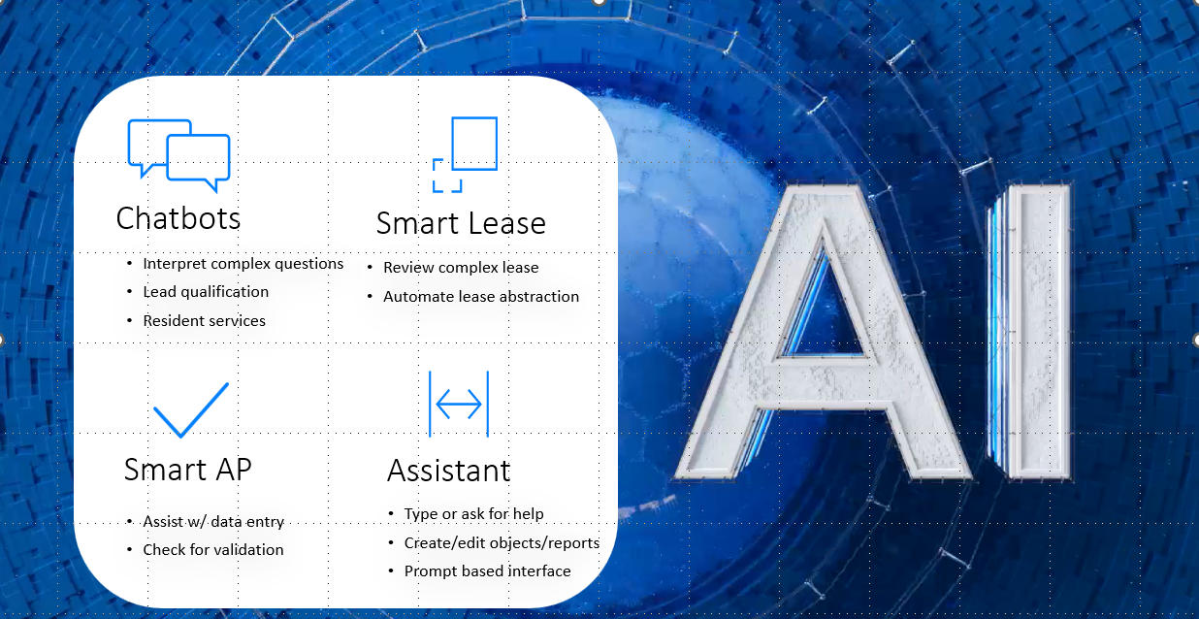
Tools in our Industry

Slide 20
Chat Bots
AI-powered “agents” integrated in PM software to help clients to:
Answer questions, handle interactions, schedule appointments
Qualify leads
Process work orders
Follow up on delinquent resident accounts
Check in on renewal offers and recertifications
Mimic and customize the tone of your brand

Slide 21
CLIENT CASE STUDY
Pre-Chat Bot
vs.
Post Chat Bot
Average days between lead & appointment
4.3
2.3
Average days between lead & tour
4.6
3.4
Average days between lead & application
13.3
9.1
Average days between lead & move-in
38.5
32.5
6-day reduction in vacancy loss!
12 months prior to Chat IQ launch versus the 12 months following
Notes:
Clients seeing consistent results like these
Running a 30% turnover rate? Then, for every 1,000 units in your portfolio, vacancy costs you $15,000 per day

Slide 22
Accounts Payable
AI tools that help process AP:
Automated workflows
Optical Character Recognition (OCR)
“Reading” and populating data fields from invoices
Data validation for accuracy
Fast processing of large volumes of documents
Full-Service AP processing from invoice to payment

Slide 23
AI Leasing
AI will dramatically change your Leasing Process:
Data analysis of marketing
Predictive tools for future behavior
Filter online interest and automate communication, replies, and offers
Screening algorithms
Automated document processing

Slide 24
Software Assistants
AI-powered agent integrated in PM software to help users to:
Reminders and task tracking
Type questions for AI software help
Enhance overall work experience
Interactive Learning Machine Systems (LMS)

Slide 25
AI Maintenance
Predictive equipment failures
Detect faults with HVAC and Water systems
Automated work orders
Cost-optimized maintenance budgets

Slide 26
AI Affordable Housing
Slower adoption of some AI features compared to market rate
Availability of reliable internet especially in rural communities
AH residents and applicants may need more human interaction
Potential to reduce Operating costs
Concerns on Fair Housing, policy, and socially reasonable goals

Slide 27
Future of AI
Theory of Mind – systems aim to understand emotions and beliefs allowing for more natural interactions with humans.
Self Awareness or Singularity – when Man and Machine Merge. American computer scientist, Ray Kurzweil, estimates it to happen before 2030 and achieved once technology is capable of 1 trillion per second.

Slide 28
Summary
AI has been around since the 1950s but is exploding today.
Will AI replace jobs in our industry?
New AI tools are expanding and changing QUICKLY. Who in your business is keeping up to date? Are you?

Slide 29


ITEX History with Ai
John Gonzalez - COS ITEX | SVP, Head of Operations + CX D: ‪(713) 635-9811 9 Greenway Plaza, Suite 1250, Houston, TX 77046

Slide 30

ITEX History with AI
May 2023
First AI Initiative: ITEX began exploring the use of Retrieval-Augmented Generation (RAG) chatbots in compliance and tenant interactions.
Goal: Enhance operational efficiency by embedding public compliance rules and proprietary training data.
Why We Adopted RAG Chatbots:
Staff Knowledge Gaps: Ensured quick access to program expertise, especially for complex compliance issues.
24/7 Availability: Allowed all staff to access a 'compliance expert' instantly.
Identify Weaknesses: Improved internal insight by identifying areas needing better support or training.

Slide 31
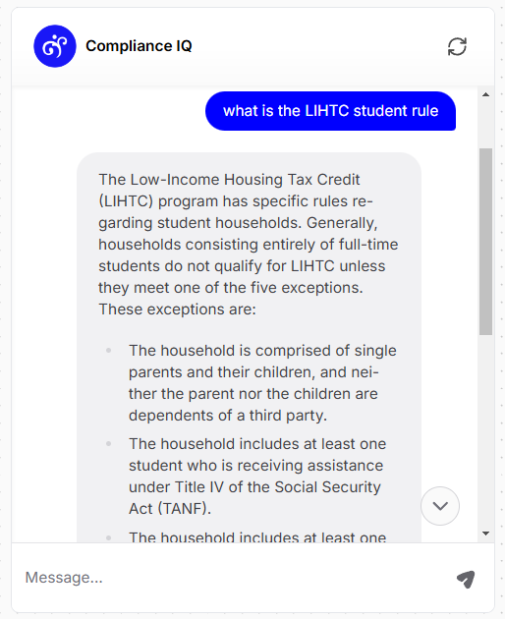
Exploring RAG Chatbots
Combines Two Technologies:
Retrieval: The chatbot pulls in relevant information from databases, documents, or policies when asked a question.
  HUD 4350.3
  Policies & Training from ITEX
Generation: It then uses that information to generate a customized, human-like response in real-time.

Slide 32
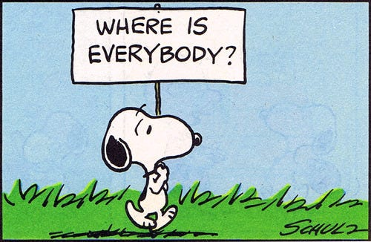
Our Measure of Success
Like many companies, we faced the issue where staff were hesitant to embrace AI.
Employees initially kept their AI experiments secret due to uncertainty about organizational impact.

Slide 33
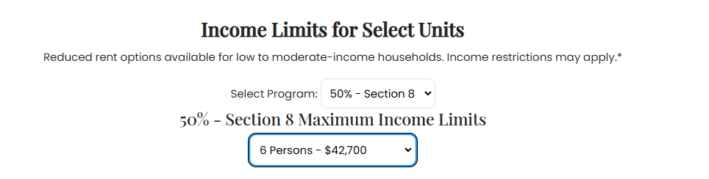

Expanding AI into Marketing
Content & Digital Marketing
Website Improvements: AI to streamline coding and optimize user experience.
Visual Enhancements: Clean up property images, add virtual furniture to floor plans.
Social Media: AI-generated captions for posts, tailored for each platform.
Ad Optimization: Real-time adjustments to ad targeting based on performance.

Slide 34
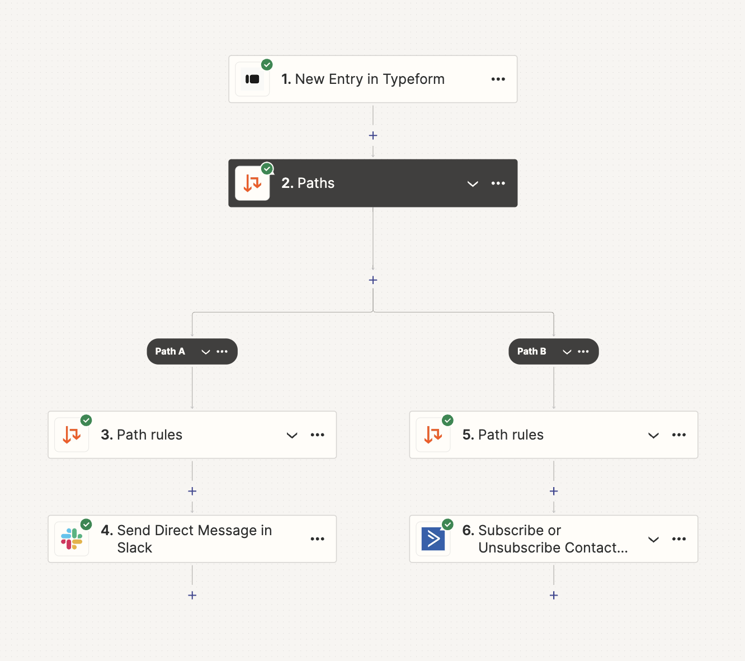
2024 Strategy
Leverage Automation & AI
We had success in marketing using AI daily to generate captions, optimize ads, and enhance visuals. This gave us a blueprint.
2024 Focus: Department-Wide Expansion: Our goal is to expand AI and automation beyond marketing into other key areas of the business—HR, compliance, and operations. This includes training teams on how to effectively use generative AI and automation to streamline tasks.
Process and technology scrutiny; do our tools communicate with each other or where is there waste in process.

Slide 35
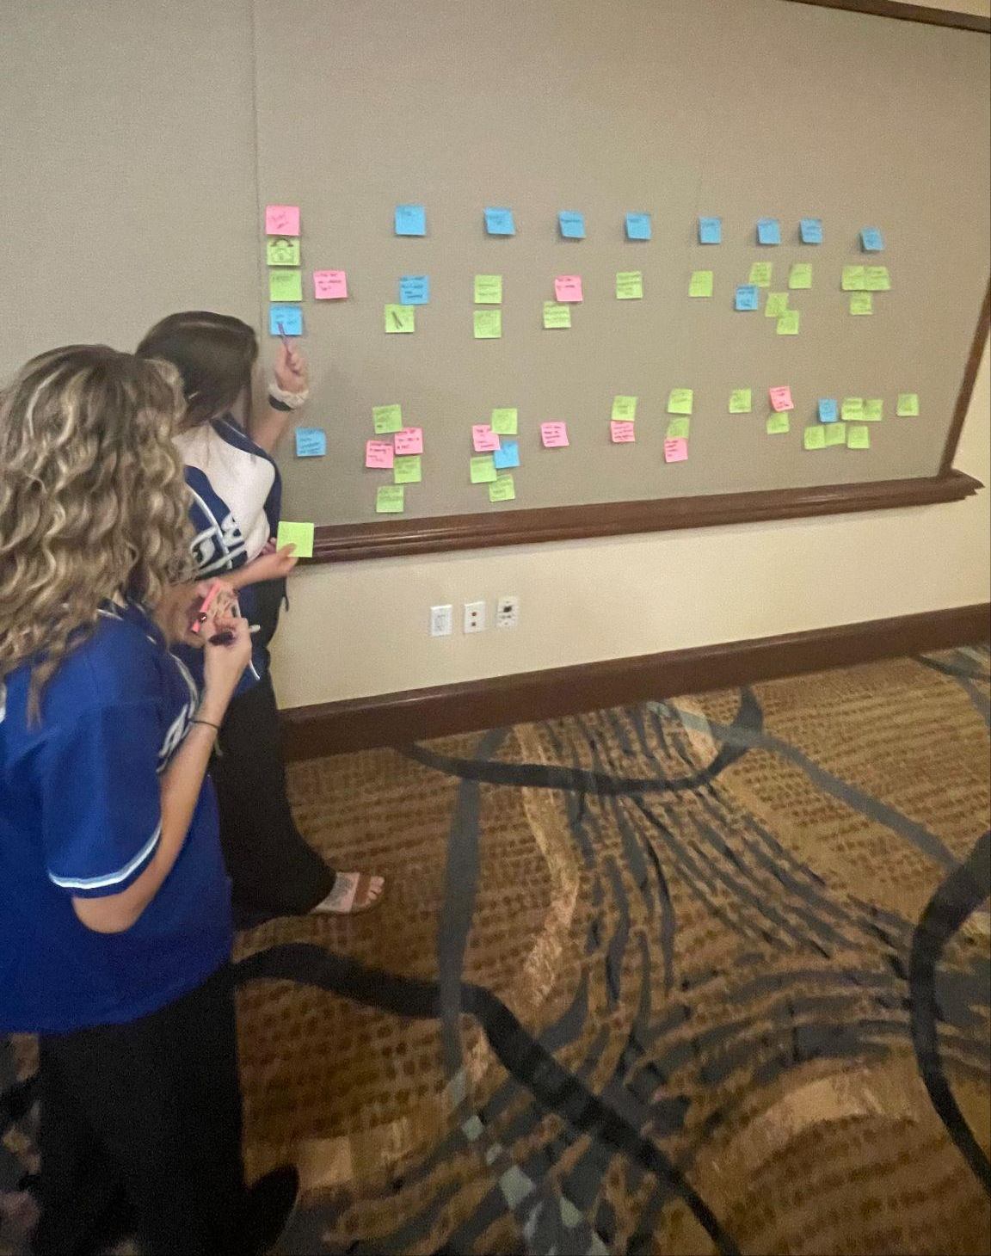
Aligning Processes & Tech Stack
Streamlining Tech for Maximum Efficiency
Review Current Systems: Yardi, Asana, RentCafe. Sharefile, Dropbox, Drive, Gmail, Etc
Automating Integration: Bridge gaps, reduce manual input.
Optimizing Workflows: Identify inefficiencies and automate.

Slide 36
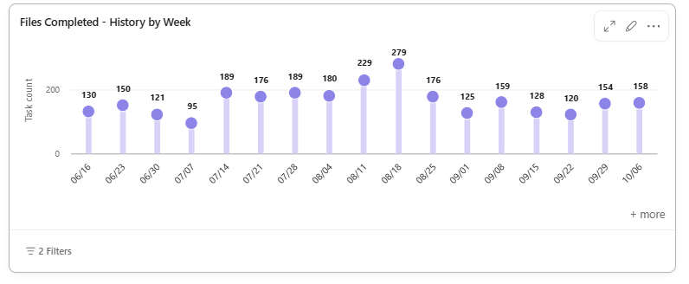
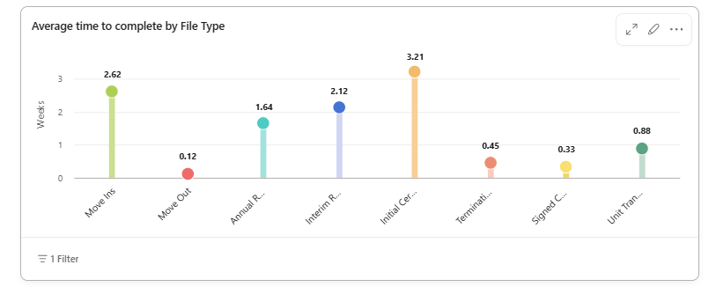
AI Integration with Compliance
Transforming Compliance with AI
Initial Evaluation: Mapped processes and identified inefficiencies.
AI Training: Taught best practices, prompt creation, and AI safety.
Time Savings: Automated file uploads and streamlined project management.
RAG Chatbot 2.0: Transitioned to a subject matter expert, providing real-time answers.

Slide 37
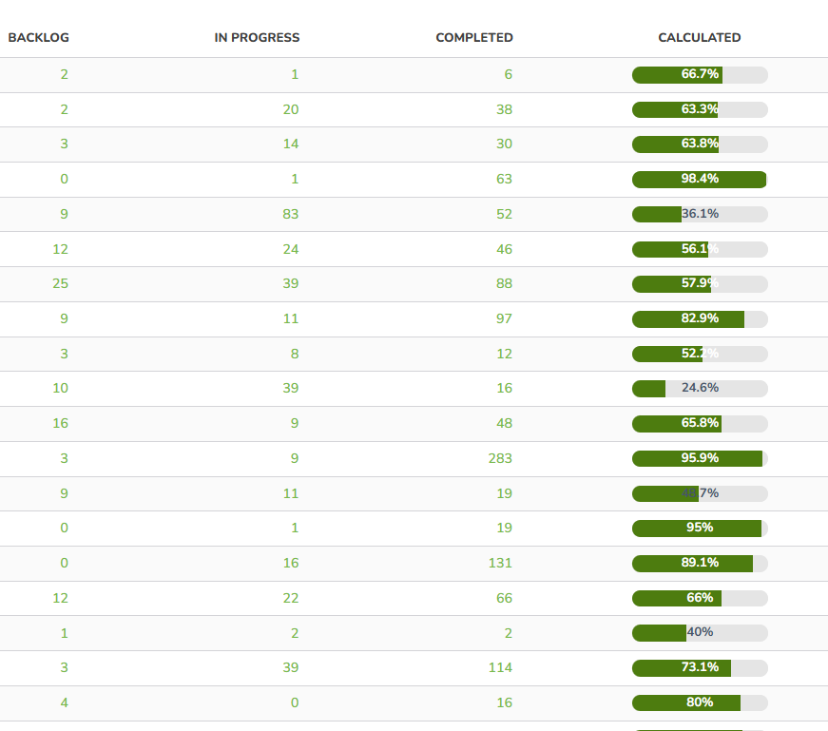
Measurable Benefits from AI in Compliance
Results After AI Implementation
30% Time Savings: Between Automation and Project Management Software
Error Reduction: AI-assisted compliance checks improved accuracy.
Faster Decisions: RAG chatbot provided real-time answers, reducing research time.

Slide 38

Challenges & Lessons Learned
Challenges in Scaling AI at ITEX
Initial Resistance: Overcame concerns about job security and AI’s role.
Training Gaps: Addressed early challenges in getting staff to use AI tools properly.
Continuous Adjustment: AI tools required iterative fine-tuning for best results.

Slide 39
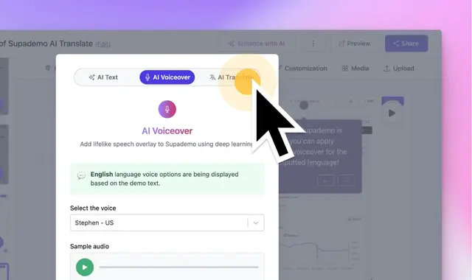
The Future of AI at ITEX
2024 and Beyond: Expanding AI Across ITEX
Expansion: We selectively roll it out where it makes the most sense, sometimes native within a software or department
Improved Communication: AI-driven tools enhancing cross-department collaboration.
Long-Term Goal: AI as a key part of decision-making across the organization.

Slide 40
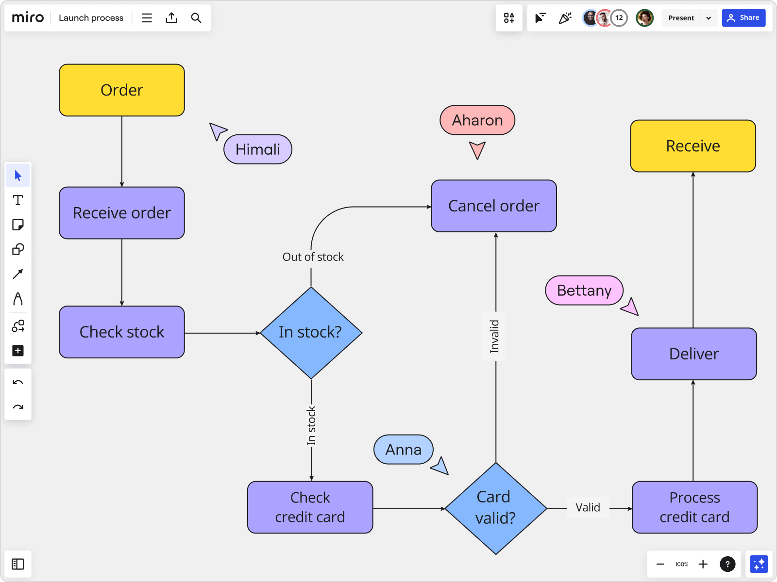
Key Takeaways for AI Adoption
What We Learned About AI
Widespread AI Use: Studies show 30-65% of employees in sectors like marketing, journalism, and law are already using AI tools.
Employee Hesitation: Fear of job loss or being replaced by AI holds employees back from sharing their use of AI.
Start Small, Then Scale: Organizations that begin with one department see faster success before expanding across teams.

Slide 41
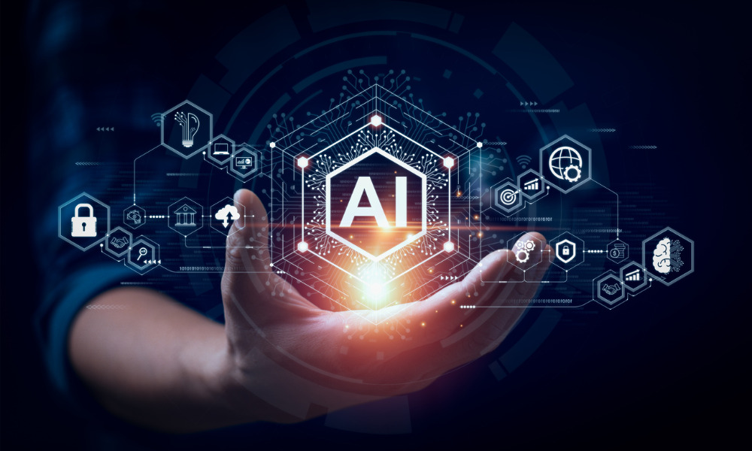
How to Start Your AI Journey
Next Steps for AI in Your Organization
Identify Opportunities: Look for processes that can benefit from automation or AI.
Choose the Right Tools: Not every tool fits—pick those that align with your goals.
Build an AI Culture: Encourage teams to experiment with AI and share their successes.
Measure: Determine how to measure success

Slide 42

Why AI Use Needs a Custom Approach
Prepare for Long-Term AI Adoption
AI Isn't Plug-and-Play: Even top AI companies don’t know how their models will fit into each unique organization without trial and error.
Iterative Process: Discovering how AI integrates into your workflows takes time, and you’ll need to experiment with different use cases.
Competitive Advantage: Companies that invest in custom R&D see better results than those that adopt off-the-shelf tools. You’ll find what works faster by having a dedicated team.

Slide 43

Challenges to AI Adoption in Organizations
Why AI Doesn't Always Lead to Immediate Gains
Individual Success ≠ Organizational Success: AI tools can boost individual productivity, but translating that into organizational performance requires more effort.
Lack of Visibility: Employees are often experimenting in secret due to fear of job loss or punishment. This stops their AI experiments from being scaled across the company.
Psychological Safety: Building an environment where employees feel safe to share their AI use is crucial for scaling innovation.

Slide 44
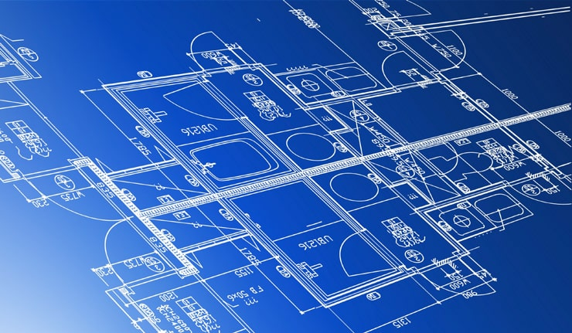
Building Your Own AI Blueprint
How to Create AI Solutions for Your Company
Crowdsource Innovation: Many of the best AI use cases come from on-the-ground experimentation by employees.
Establish an AI Lab: Set up an internal AI team to benchmark tools and test what works for your specific needs.
Create AI Benchmarks: Develop specific AI benchmarks for your business functions, such as document processing or customer service, to measure what’s working

Slide 45
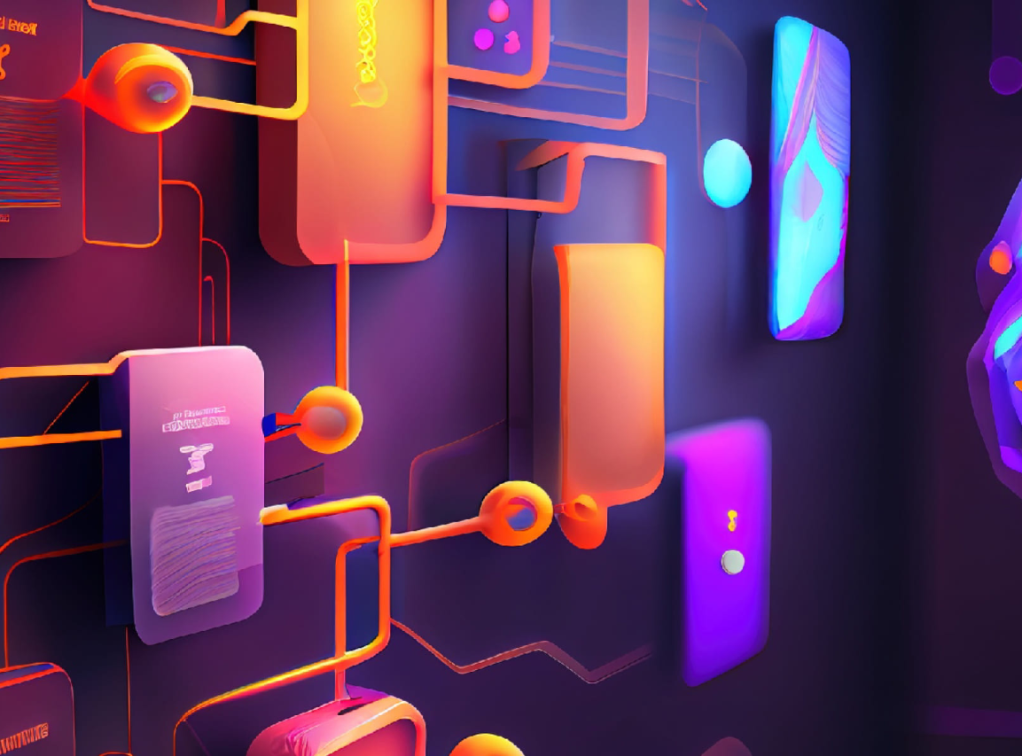
Prepare, Experiment, Scale
Key Strategies for Successful AI Adoption
Start Small, Scale Big: Begin with AI in one department, measure success, and then scale across the organization.
Foster a Safe Environment: Encourage employees to share their AI innovations without fear of job loss—psychological safety matters.
Invest in Process Improvement: While off-the-shelf AI tools are a great starting point, there’s significant opportunity in evaluating and documenting department workflows to identify where automation—not just AI—can drive efficiency. Many repetitive tasks can still be streamlined through process automation, leaving room for ongoing productivity gains across the organization.

Slide 46

www.marionnapoleon.com

Slide 47


Slide 48
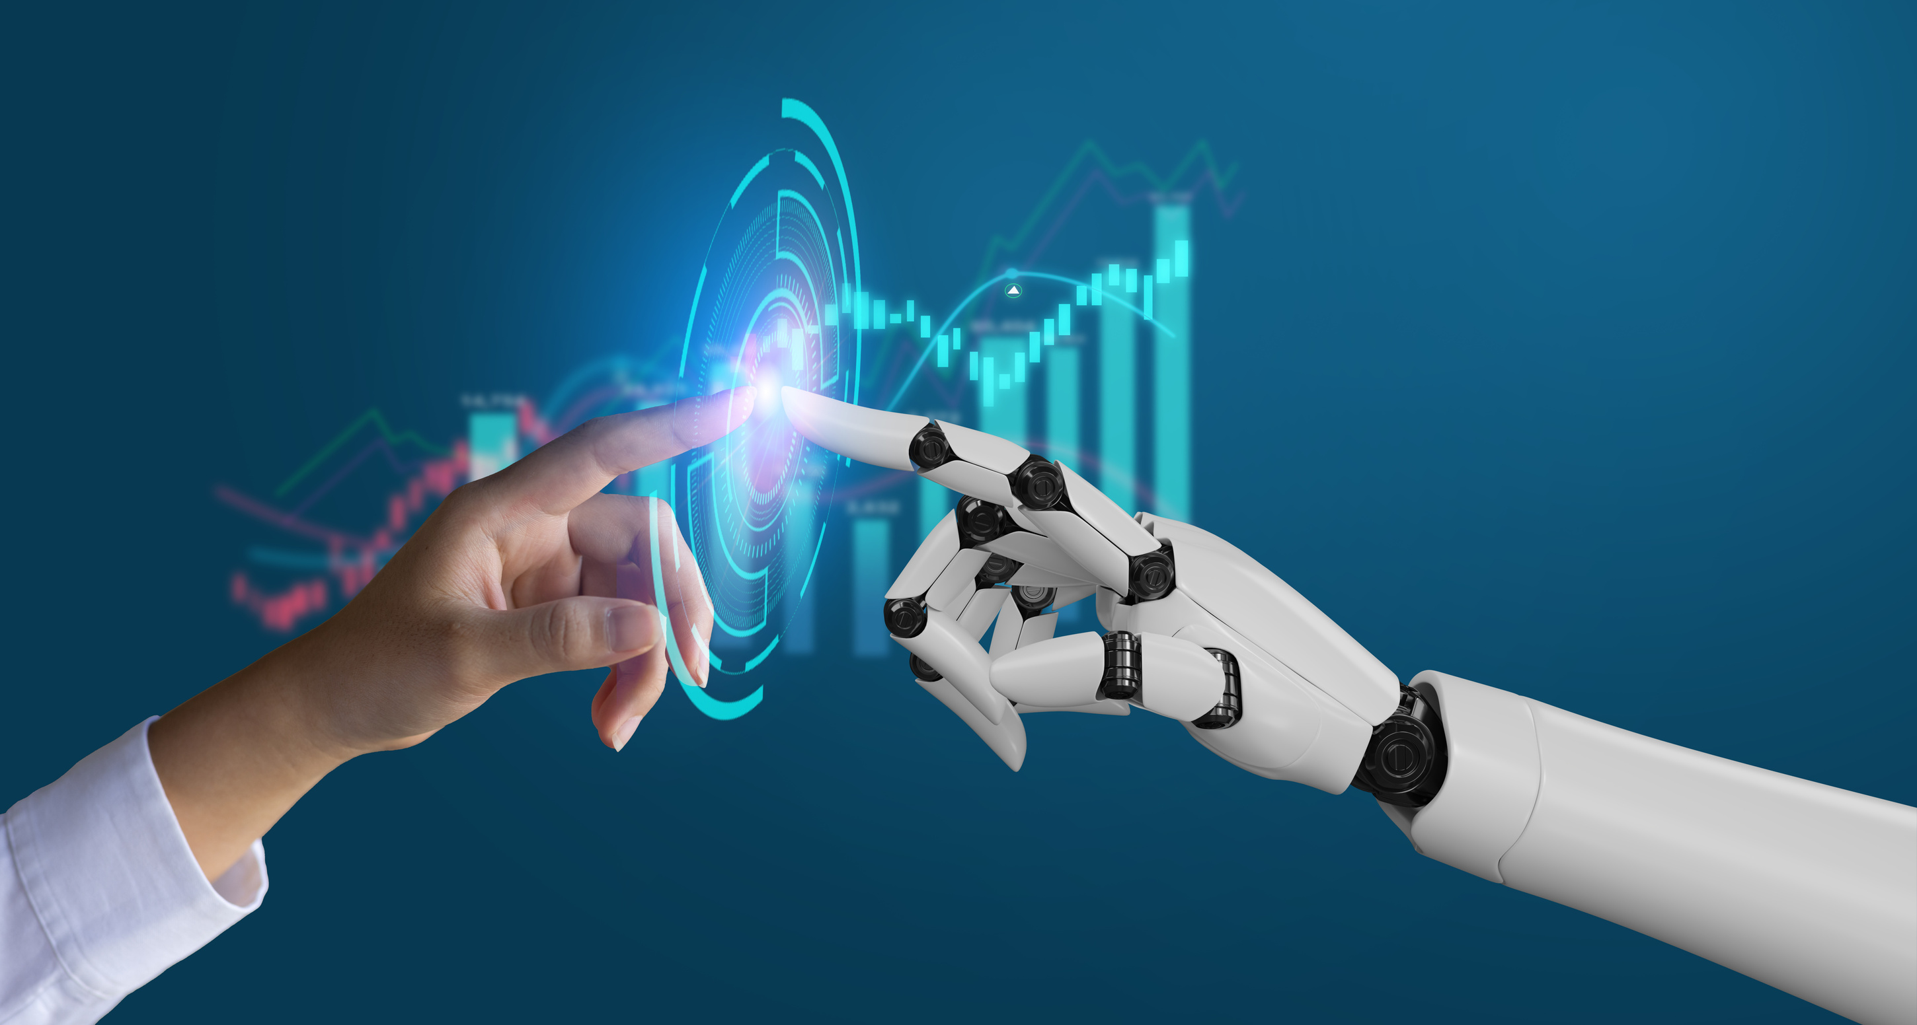
AI is Changing The World

Slide 49

Augmented Realty
AR - Overlays digital information onto the real world.
  Virtual Staging.AI

Slide 50
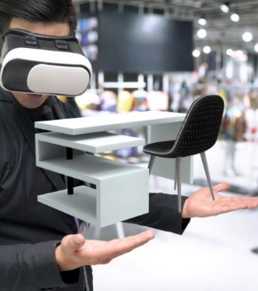
Virtual Realty
  VR - Completely replaces the real world with a simulated environment. In some environments a headset may be required.
  Virtual Property Tours

Slide 51

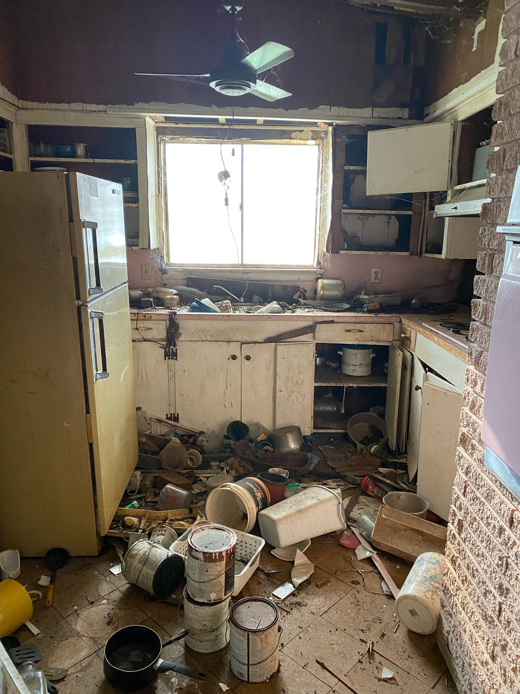

AI To The Rescue!

Slide 52
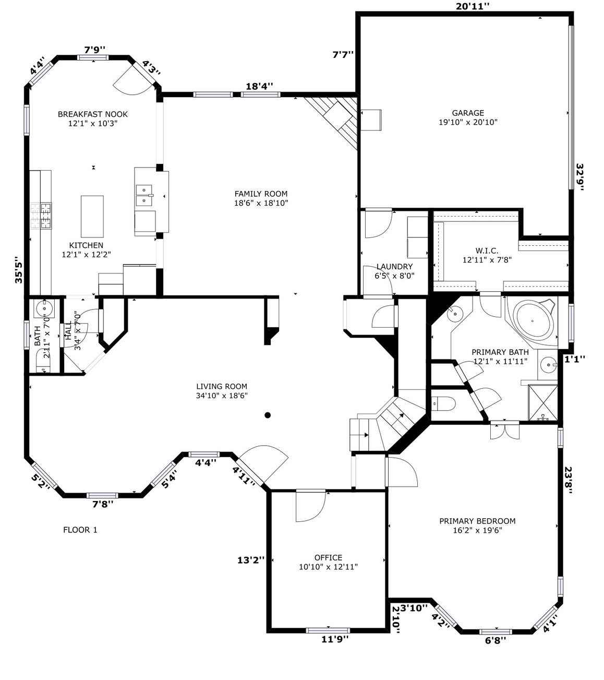
2D & 3D Floor Plans
  AI APPS – allow Realtors to create on demand floor plans and virtual tours on the spot.
  CubiCasa
  RoomSketcher

Slide 53


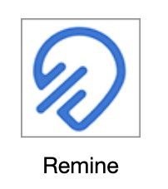

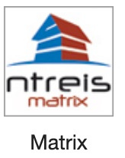
Big Data & Analytics
  AI Integration

Slide 54

AI – To The Rescue!
  Maps & Navigation
  Facial Detection & Recognition
  Text Editors & Autocorrect
  Search & Recommendations
  Digital Assistants
  Social Media
  E-Payments
  Siri & Alexa

Slide 55
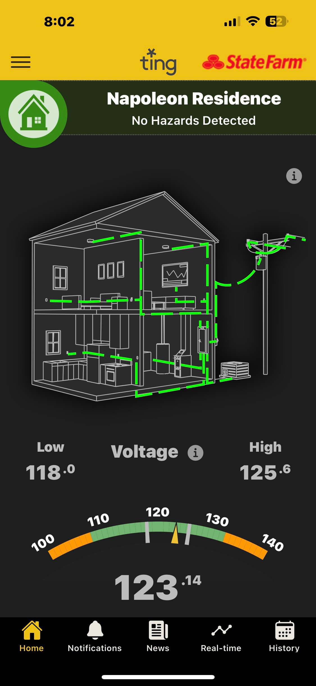
Smart Home Technology
  Smart Energy
  Smart Thermostats
  Smart Lighting
  Smart Security
  Smart Shades
  Smart Irrigation

Slide 56
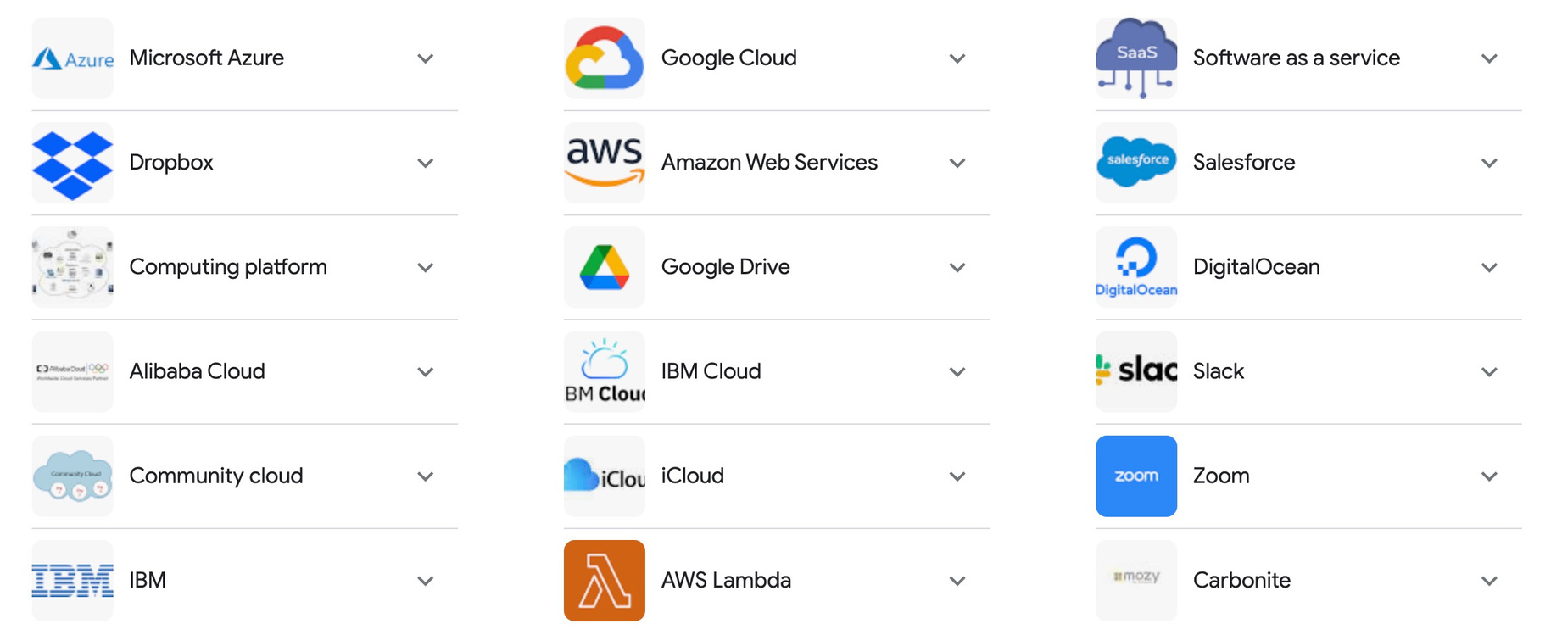
Cloud Storage

Slide 57

Cloud Computing
  Transaction Management
  Client Interactions (CRM)
  Document Management
  Marketing & Branding
  Real Time Property Data
  Document Sharing

Slide 58

Best $20.00
Ever SPENT for an Assistant!

Slide 59
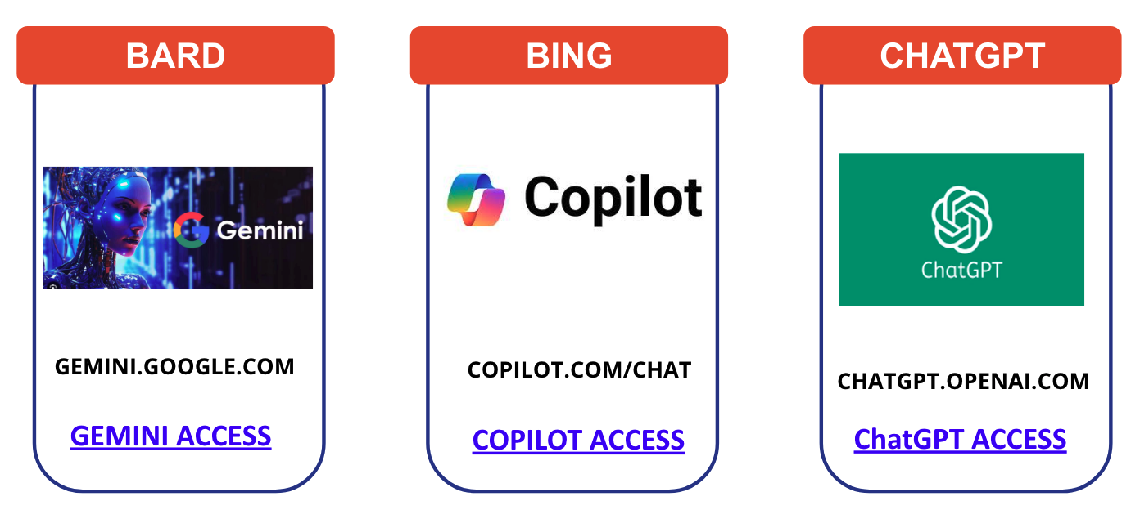
Language Models & AI Tools

Slide 60
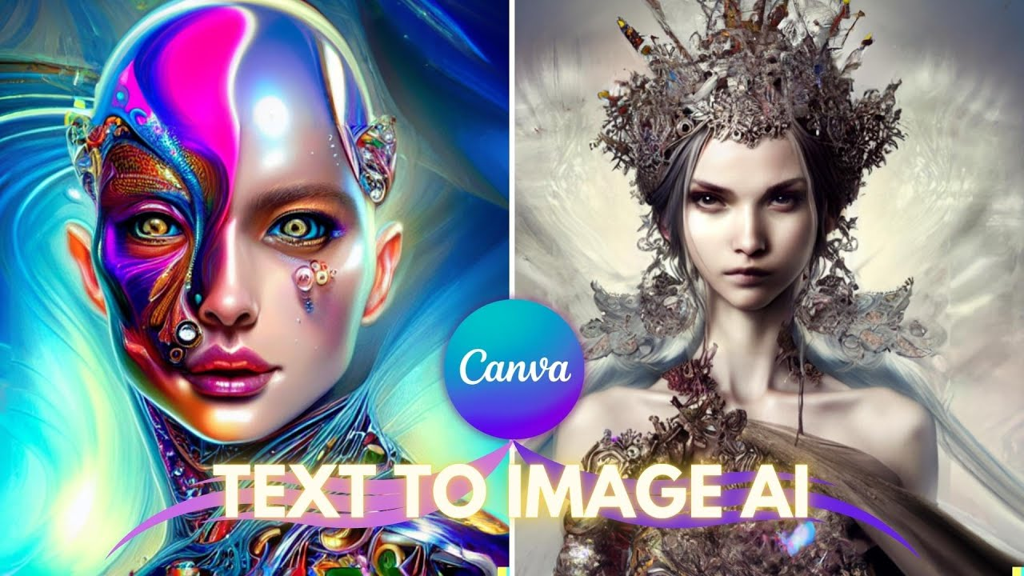
Language Models & AI Tools

Slide 61




Marketing & Headshots

Slide 62


Slide 63


